Slide 1
Kaitlin Thompson Jane M. Klausman (JMK) recipient

Slide 2
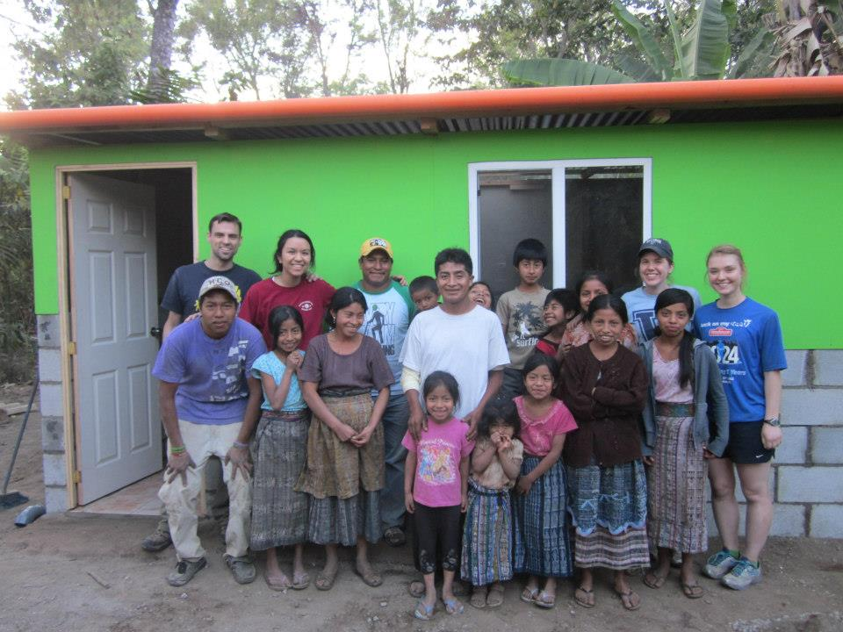
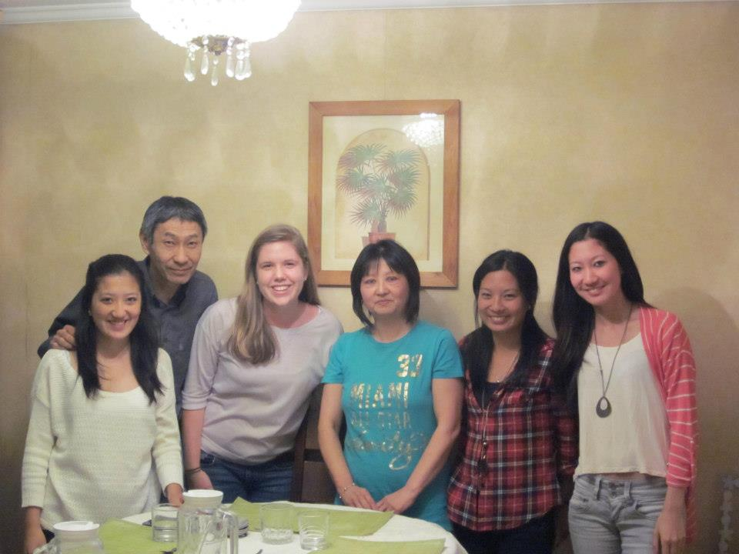
Studies
Economics and Political Science
Villanova ‘14
Worked for NGO in Madrid, Spain for two months
Studied abroad in Santiago, Chile for four months
Volunteered in Antigua, Guatemala
Researched gender wage gap

Slide 3
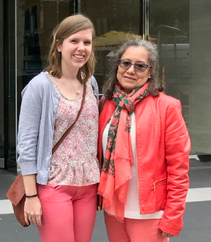
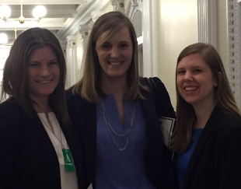
2014-2018
Four years govt consulting at PricewaterhouseCoopers
Women’s Leadership
Mentored interns and Associates
Mentoring Lead for Women’s Network
Representative at White House United State of Women summit in ‘16
Taught English as a Second Language

Slide 4
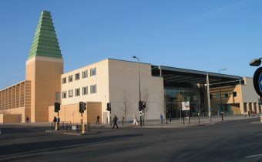
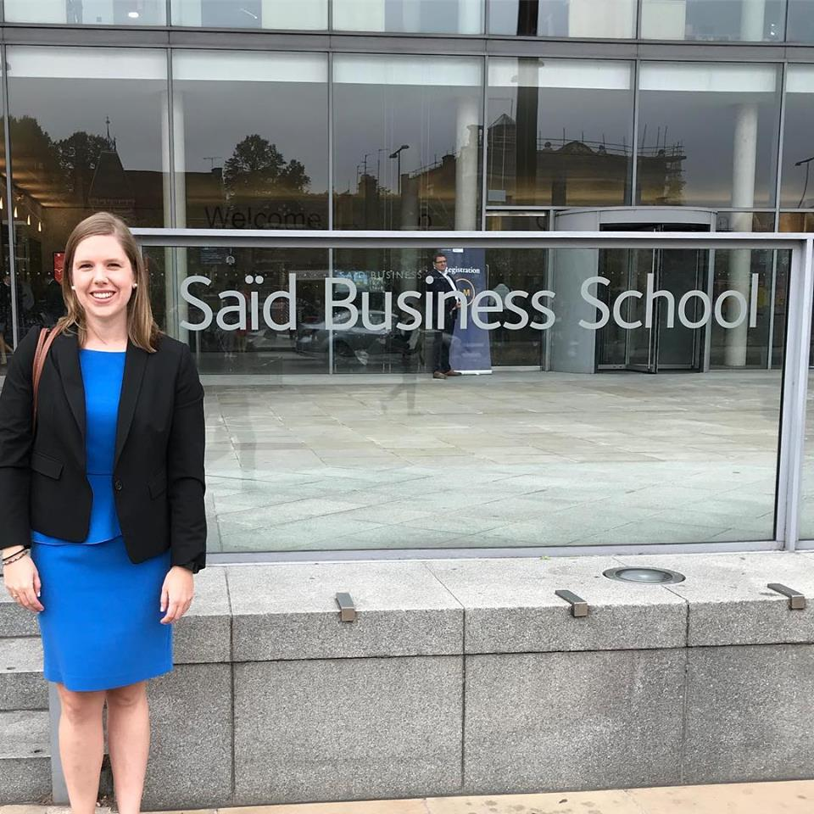
MBA at Oxford
313 students from 62 countries
One-year
Social impact

Slide 5
What’s Next
Food and beverage industry

Slide 6
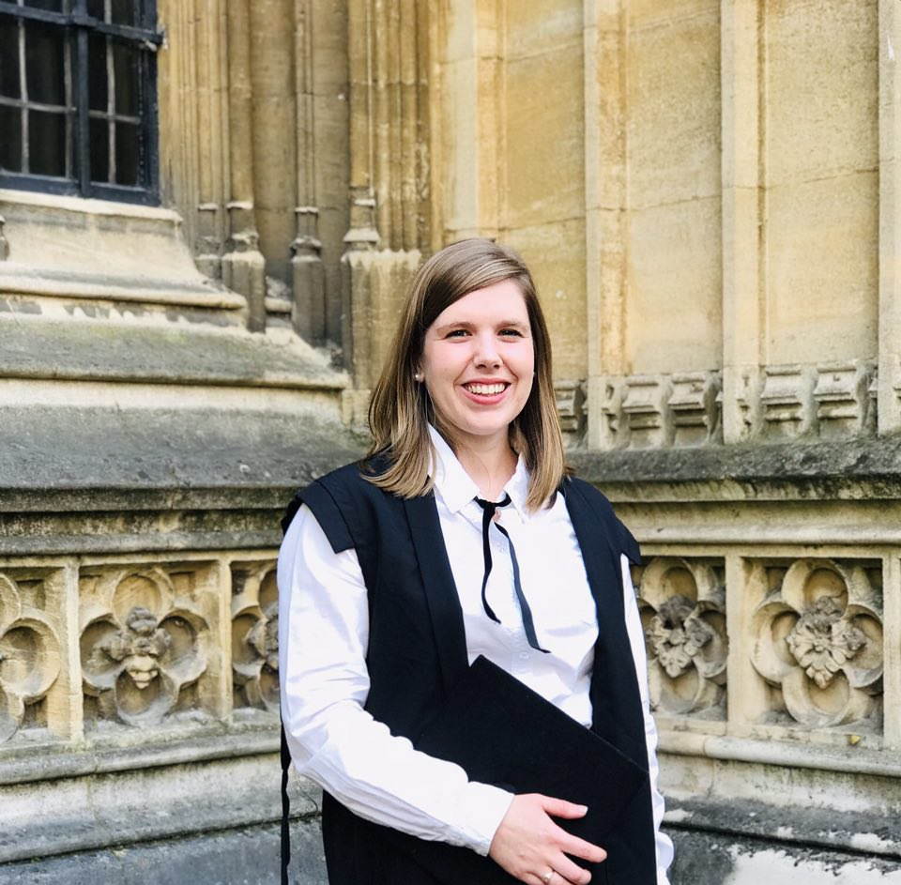
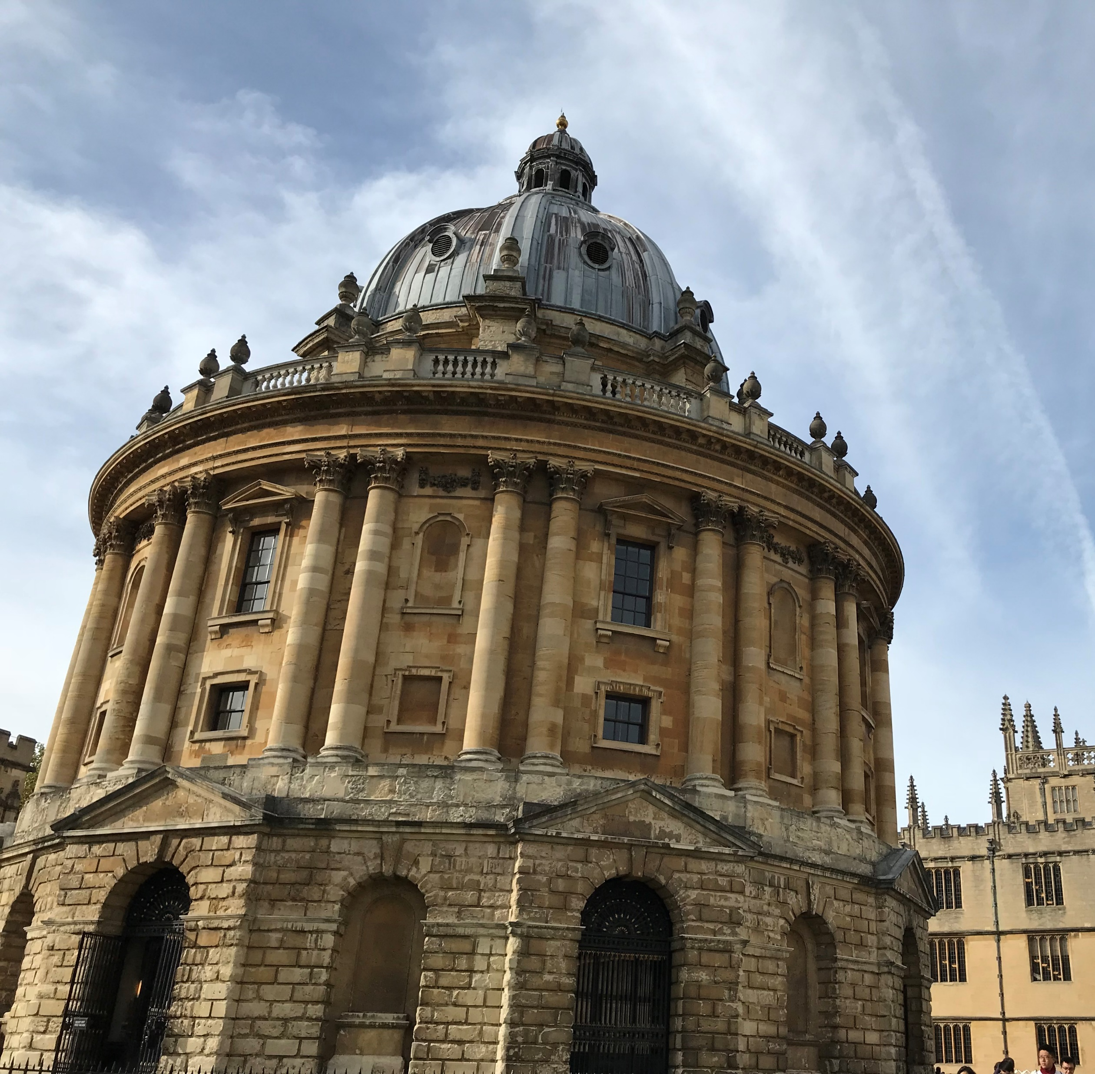
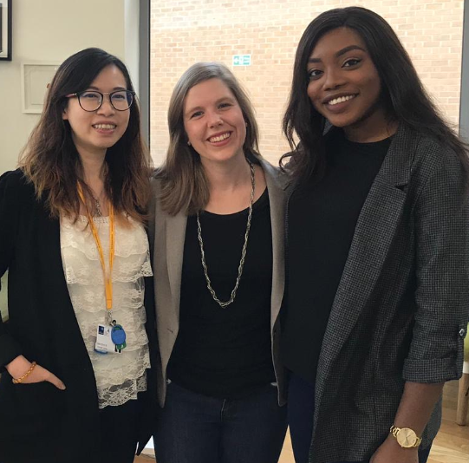
Thank You!

