Slide 1
Journey of an Amelia Earhart Fellow
Dr. Mary Bowden
Amelia Earhart Fellow 1978
University of Maryland – College Park

Slide 2
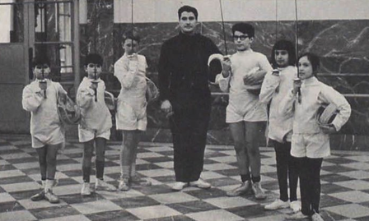
Unusual Upbringing
Big Family
New York City
Lycée Français

Slide 3
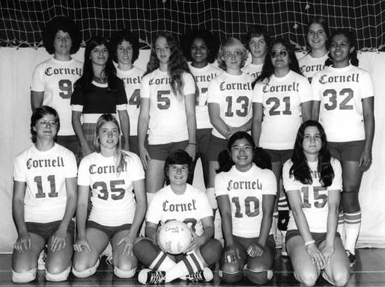
Cornell University
Math but really Engineering
Sports

Slide 4
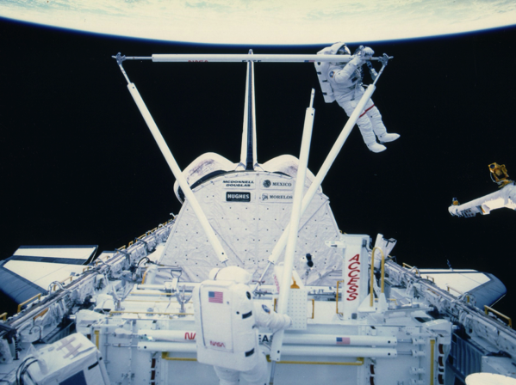
MIT & Amelia Earhart Fellowship
Aeronautics and Astronautics
Space Systems Lab
Ice Hockey

Slide 5
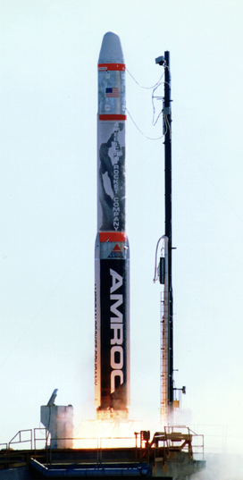
Rocket Science is not that easy!
American Rocket Company

Slide 6
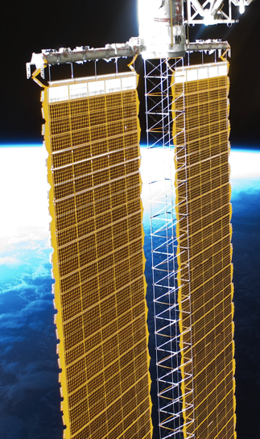
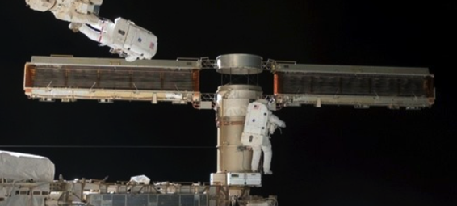
International Space Station
Solar Arrays for Power
AEC Able Engineering

Slide 7
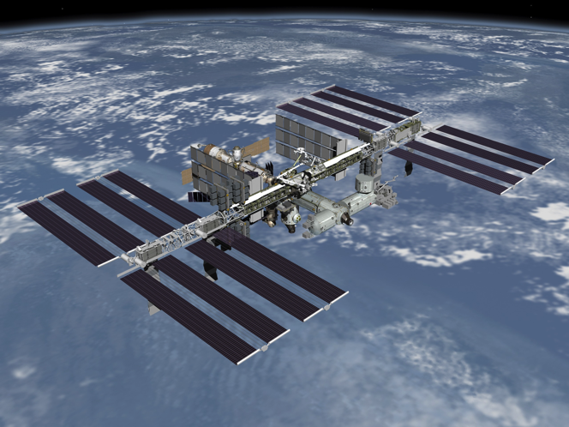
What’s so great about Aerospace Engineering?
Airplanes
Helicopters
Drones
Rockets
Satellites
GPS
Space Stations
Moon Bases
Mars Rovers
Explorers
Space Telescopes
High Precision Systems Designed Right on the Edge!

Slide 8
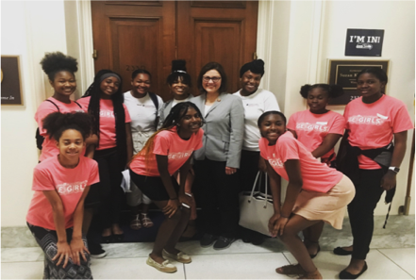
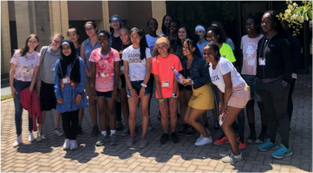
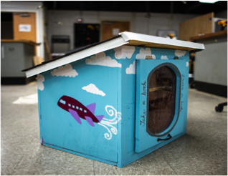
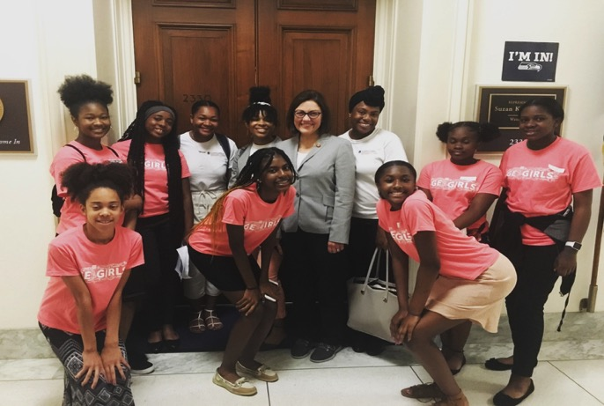
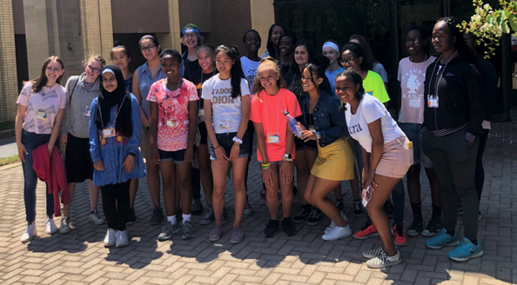
University of Maryland - CP
Women in Engineering Program

Slide 9
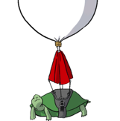
Near-Space Program
Turns out it’s pretty expensive to get things into space!
How can we test payloads cheaply?
Near-Space - a good way to perform experiments in an environment similar to Space: High Altitude Balloon Flights!
Space
Systems
Laboratory

Slide 10
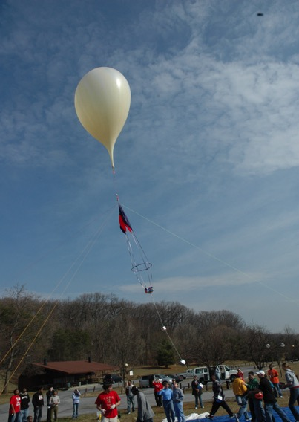
UMD Balloon Launch Operation
Balloon & Parachute
Command Module
Tracking Modules
Payloads
Cut-Down Device
Ground Station
Predictions
Tracking
Recovery

Slide 11
Payloads being readied for flight

Slide 12
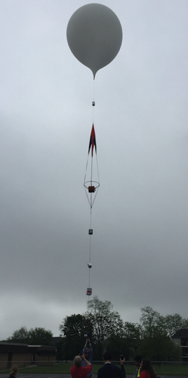
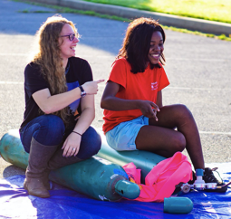
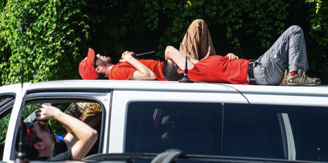
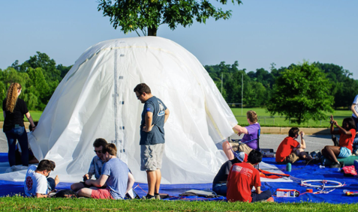
Balloon Launches can be Fun!

Slide 14
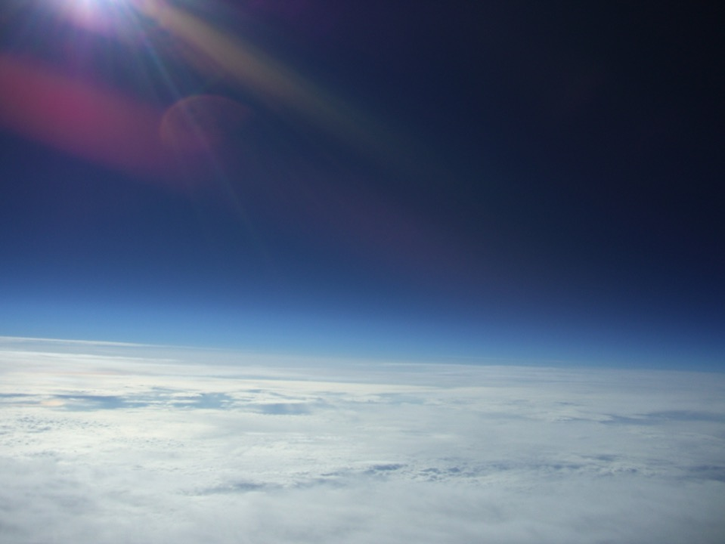

Slide 15
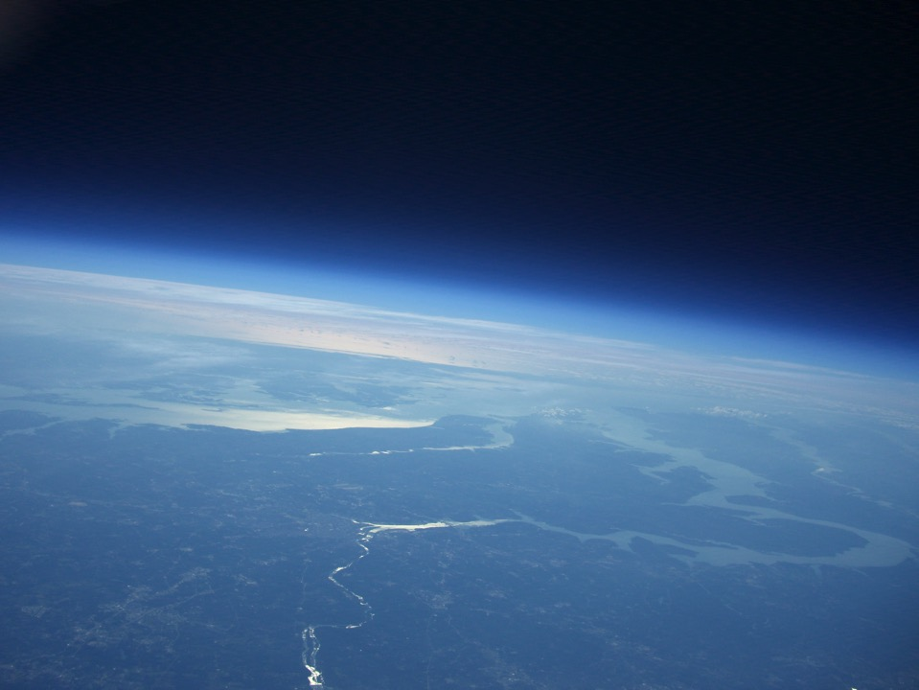
Maryland From 90,000 Feet

Slide 16
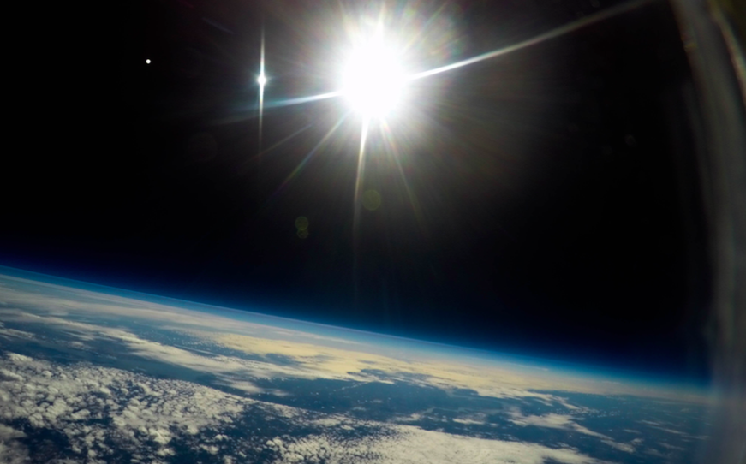
Blackness of space Picture

Slide 17
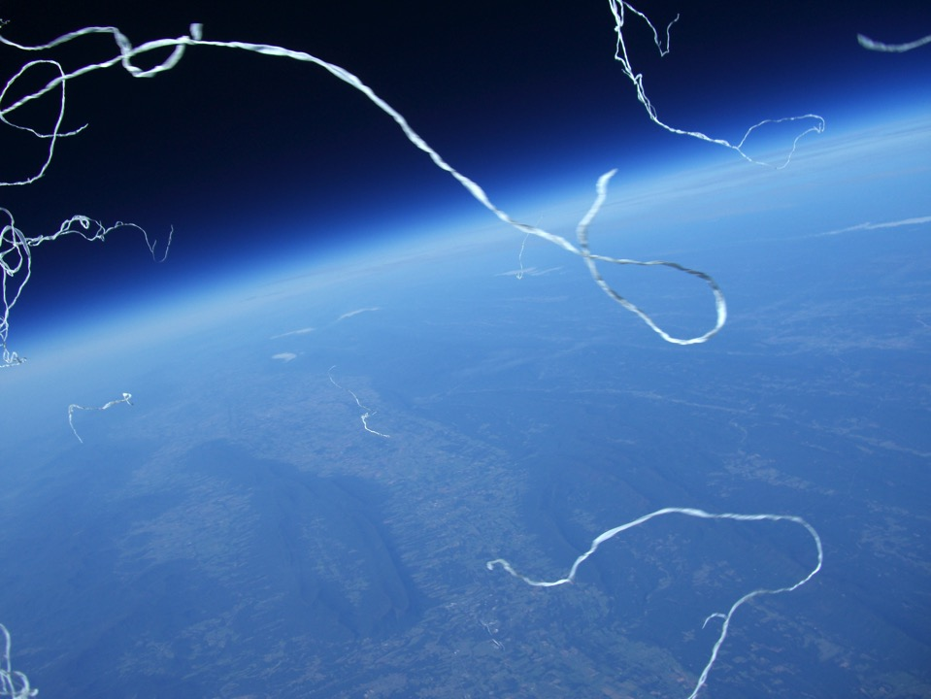
Balloon Burst (NS-15)

Slide 18
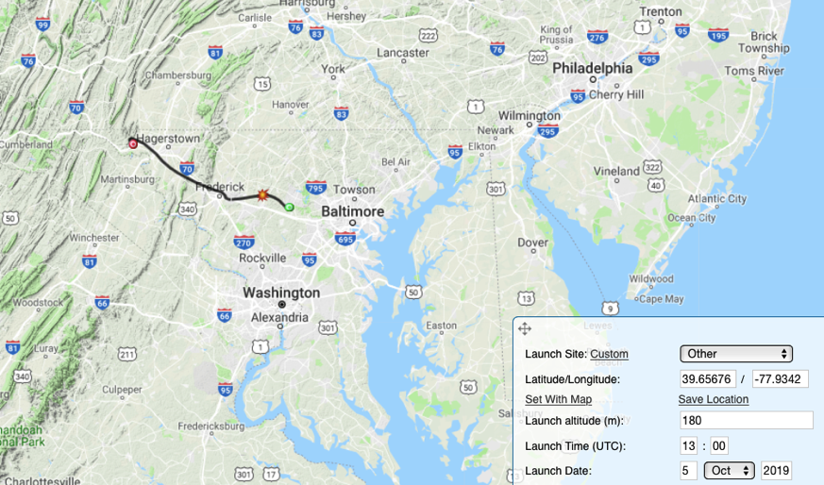
Ground Track Prediction
Winds aloft data from NOAA combined with estimated rise rate and burst altitude
allow fairly accurate predictions of ground track.

Slide 19
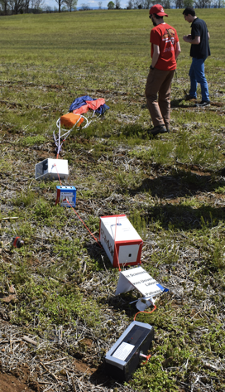
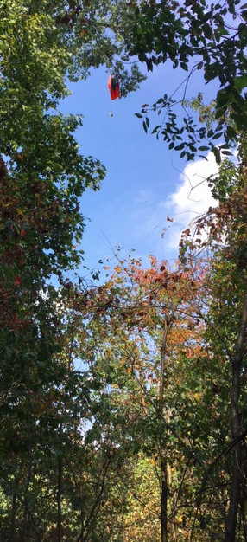
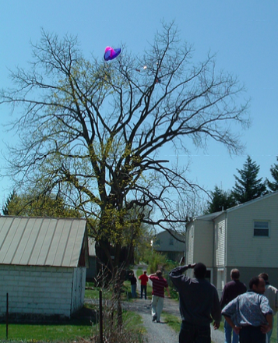
Landings can be challenging!

Slide 20
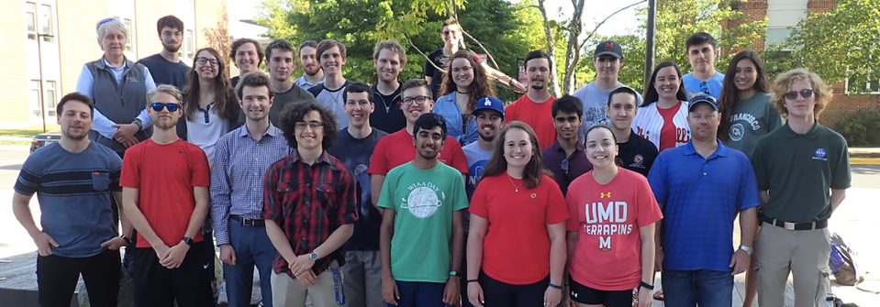
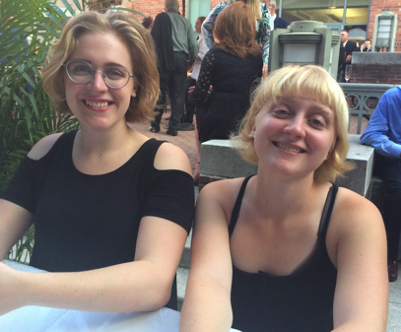
What I am most proud of …
My students
My kids!

Slide 21
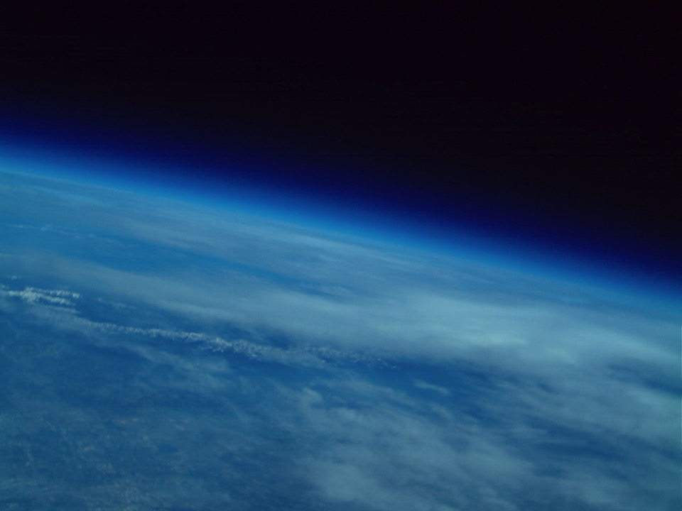
Thank You

Slide 22
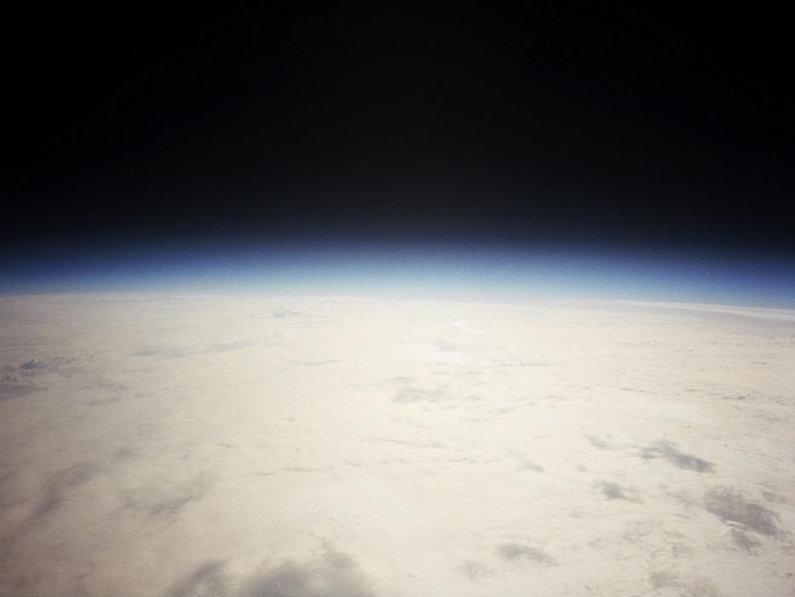
Questions?
Next Launch:
Saturday 19 October 2019
8:00 am Clear Spring, MD

Slide 23
