Slide 1
100 Years of Empowering Women Governor’s Seminar Presentation October 2018

Slide 2
Agenda
2018-2019 Action Plan
Awards
Events
Awareness
Centennial Anniversary Grants
Centennial Tools & Resources
Common Day of Action

Slide 3
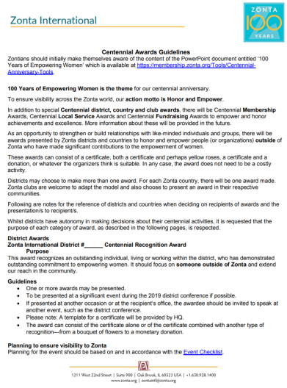
2018-2019 Actions
Centennial Anniversary Endowment Campaign
Centennial Awards
Branding, Branding, Branding

Slide 4
Centennial Anniversary Grants
Awarded from Zonta International Foundation to organizations with whom we partner.
Details:
Each Grant: Maximum $5,000
Total Sum: $300,000
Disbursement: First Come, First Served
Applications must be made online at zontacentennialgrants.awardspring.com Hard copy and email applications will not be accepted.
Applications may only be initiated by a Zonta club.

Slide 5
Centennial Tools & Resources
www.zonta100.org
https://membership.zonta.org/Tools/Centennial-Anniversary-Tools

Slide 6
Common Day of Action
Thursday
8 November
2018

Slide 7
Common Day of Action
Goal 1
We maximize our impact through service and advocacy initiatives and educational programs that empower women and girls.
Our Approach
Eliminate one of the most devastating obstacles girls are facing globally: early marriage
Zonta clubs around the world are called upon to create awareness of this harmful practice
Zonta Says No = Signature initiative for Zonta

Slide 8
Common Day of Action
Goal 3
We enhance our profile around the world through our Centennial Anniversary activities.
Our Approach
We utilize Zonta’s Centennial Anniversary to deepen and enhance our relations with supporting individuals and organizations and to raise awareness of our activities and achievements.

Slide 9
Common Day of Action
Social
Media
Takeover

Slide 10
Common Day of Action

Slide 11
Common Day of Action
Instagram
Download Repost for Instagram
Search for Zonta International
Select Post from September 6th
Tap the 3 dots button in the upper right corner
Tap the button labeled Copy Link
Open Repost for Instagram
Tap the Repost Button

Slide 12
Common Day of Action
Instagram to Facebook
Go back to the original post
Tap the 3 dots button in the upper right corner
Select Share to Facebook
Personalize your post
Click Post to Facebook

Slide 13
Common Day of Action
Instagram to Twitter
Go Back to the original post
Tap the 3 dots button in the upper right corner
Select Share to Twitter
Personalize text
Click Tweet

Slide 14
Common Day of Action
Don’t Have Instagram?
Facebook: Go to the Zonta District 3 Facebook Page
Find the post
Click Share
“Say something about this post” to Personalize
Click Share Now

Slide 15
Common Day of Action
Thursday
8 November
2018

Slide 16
Questions?

