Slide 1
District 3 PHOTO GALLERY

Slide 2
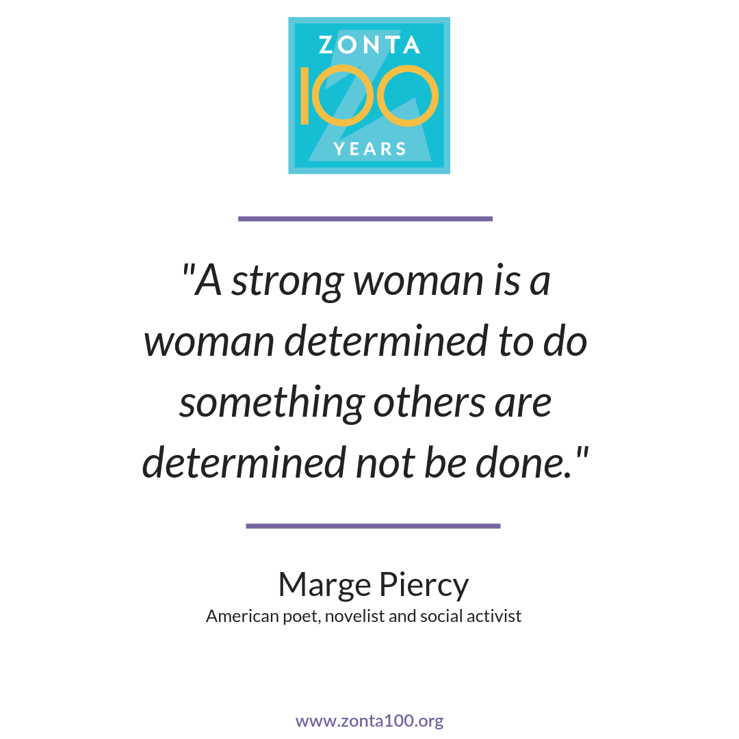

Slide 3
ZONTA INTERNATIONAL HISTORY

Slide 4
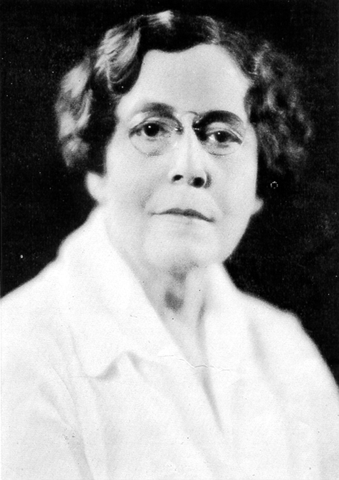
Marian de Forest
Marian de Forest was an extraordinary woman who contributed greatly to the Buffalo community.
A Buffalo native, she worked as a reporter, drama critic and editor of the women’s department of the city newspaper.
She was also a playwright best known for writing and producing Little Women, based on the Louisa May Alcott novel.
She was instrumental in bringing music to the children of Buffalo through the Buffalo Music Foundation which she co-founded.
Marian was the executive secretary of the Board of Women Managers for the Women’s Pavilion for the 1901 Pan American Exposition in Buffalo.
Marian is universally acknowledged as the founder of Zonta, in 1919.

Slide 5
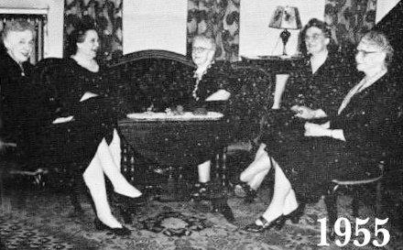
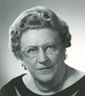
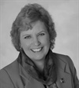

Slide 7
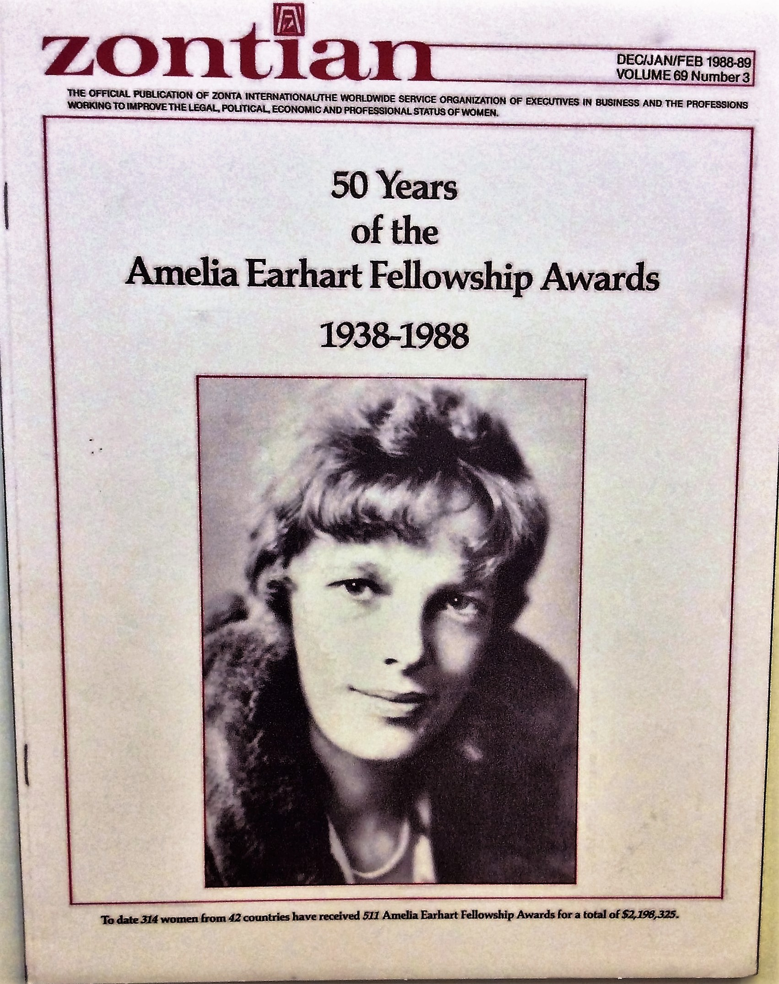
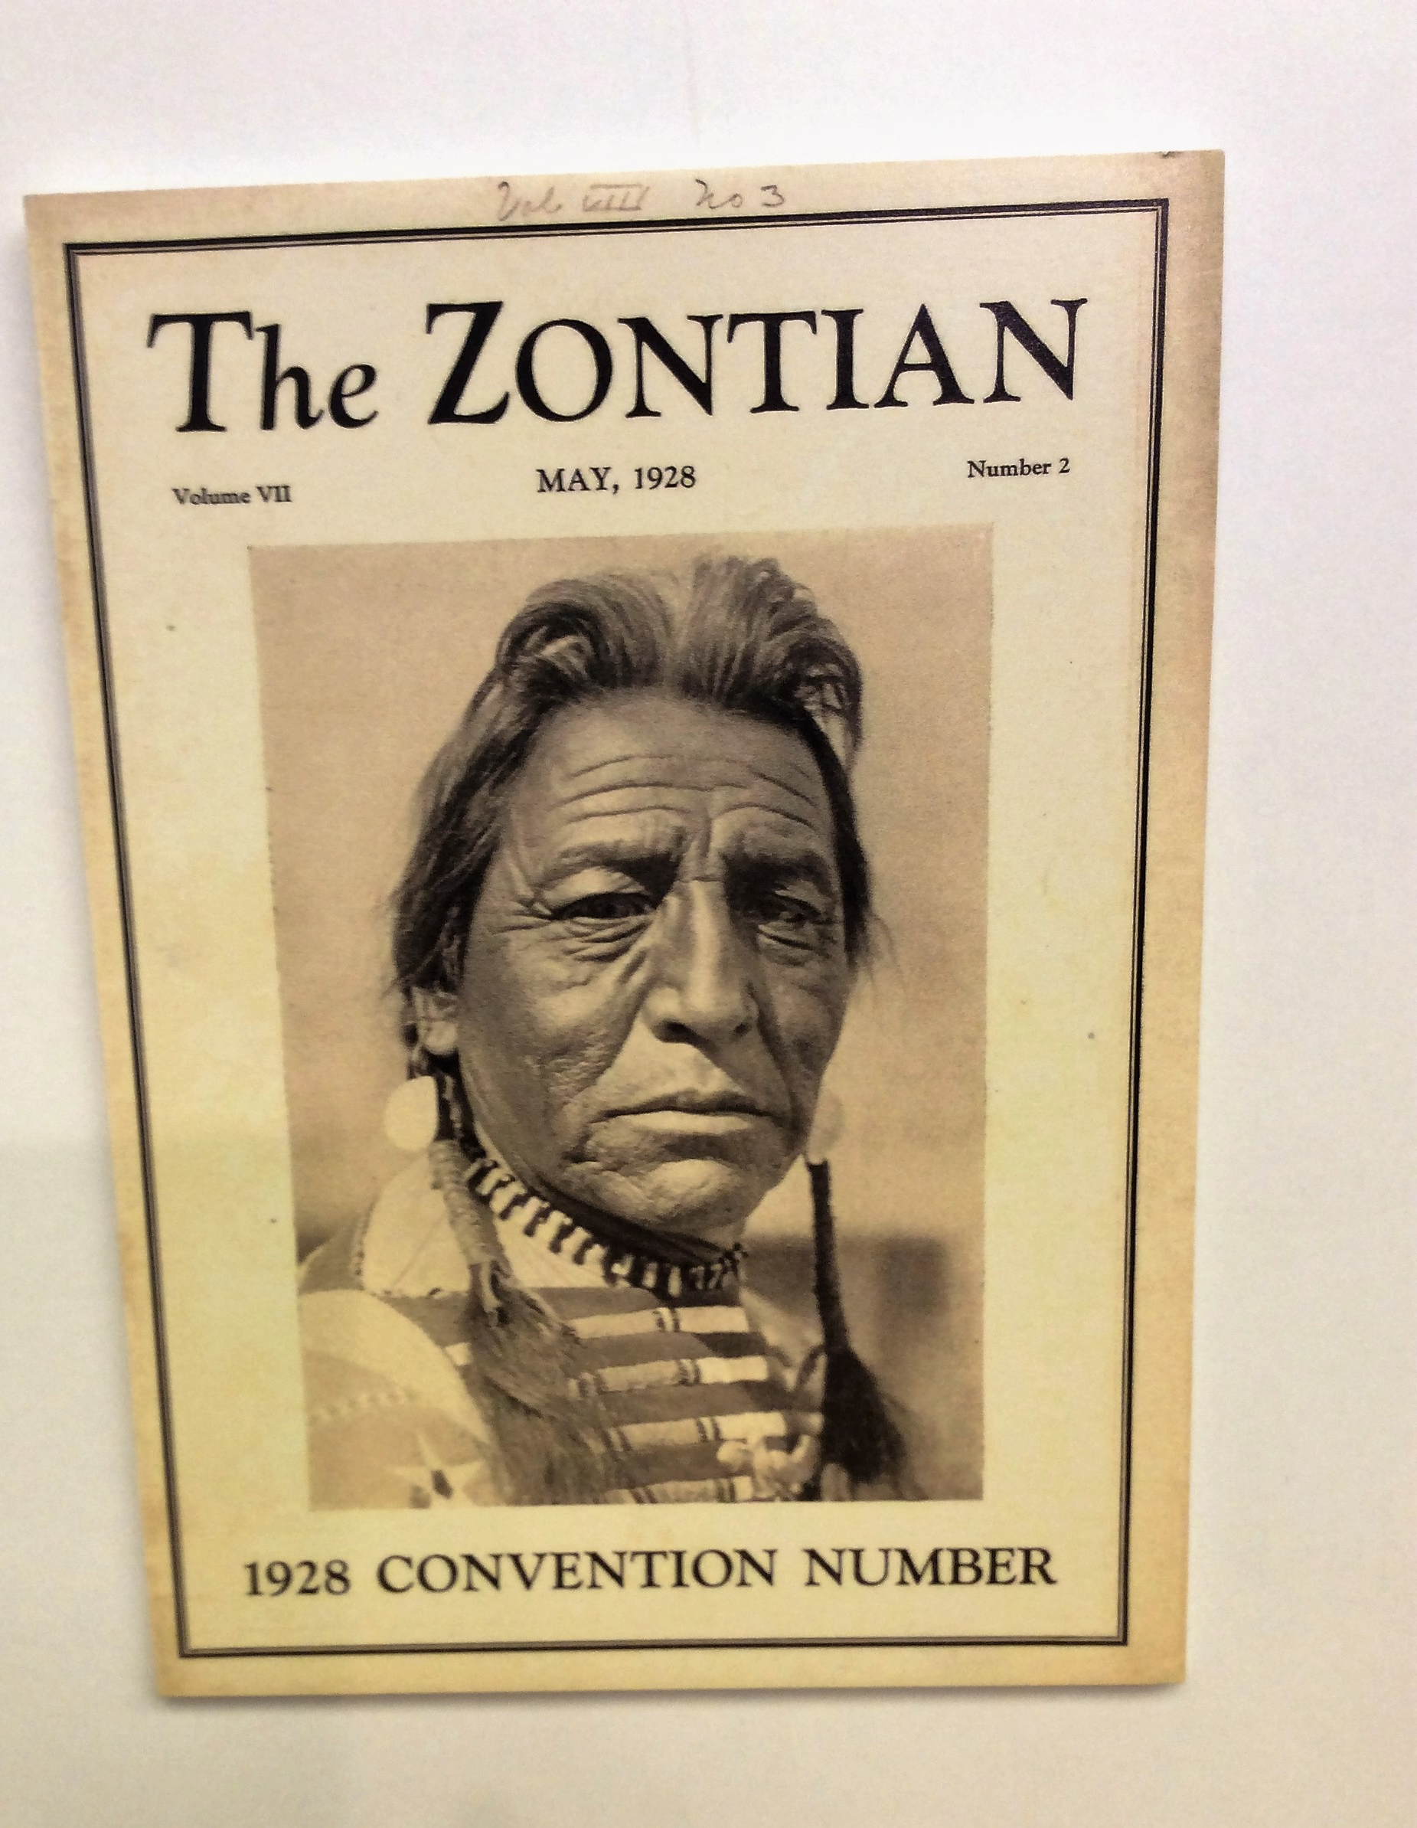
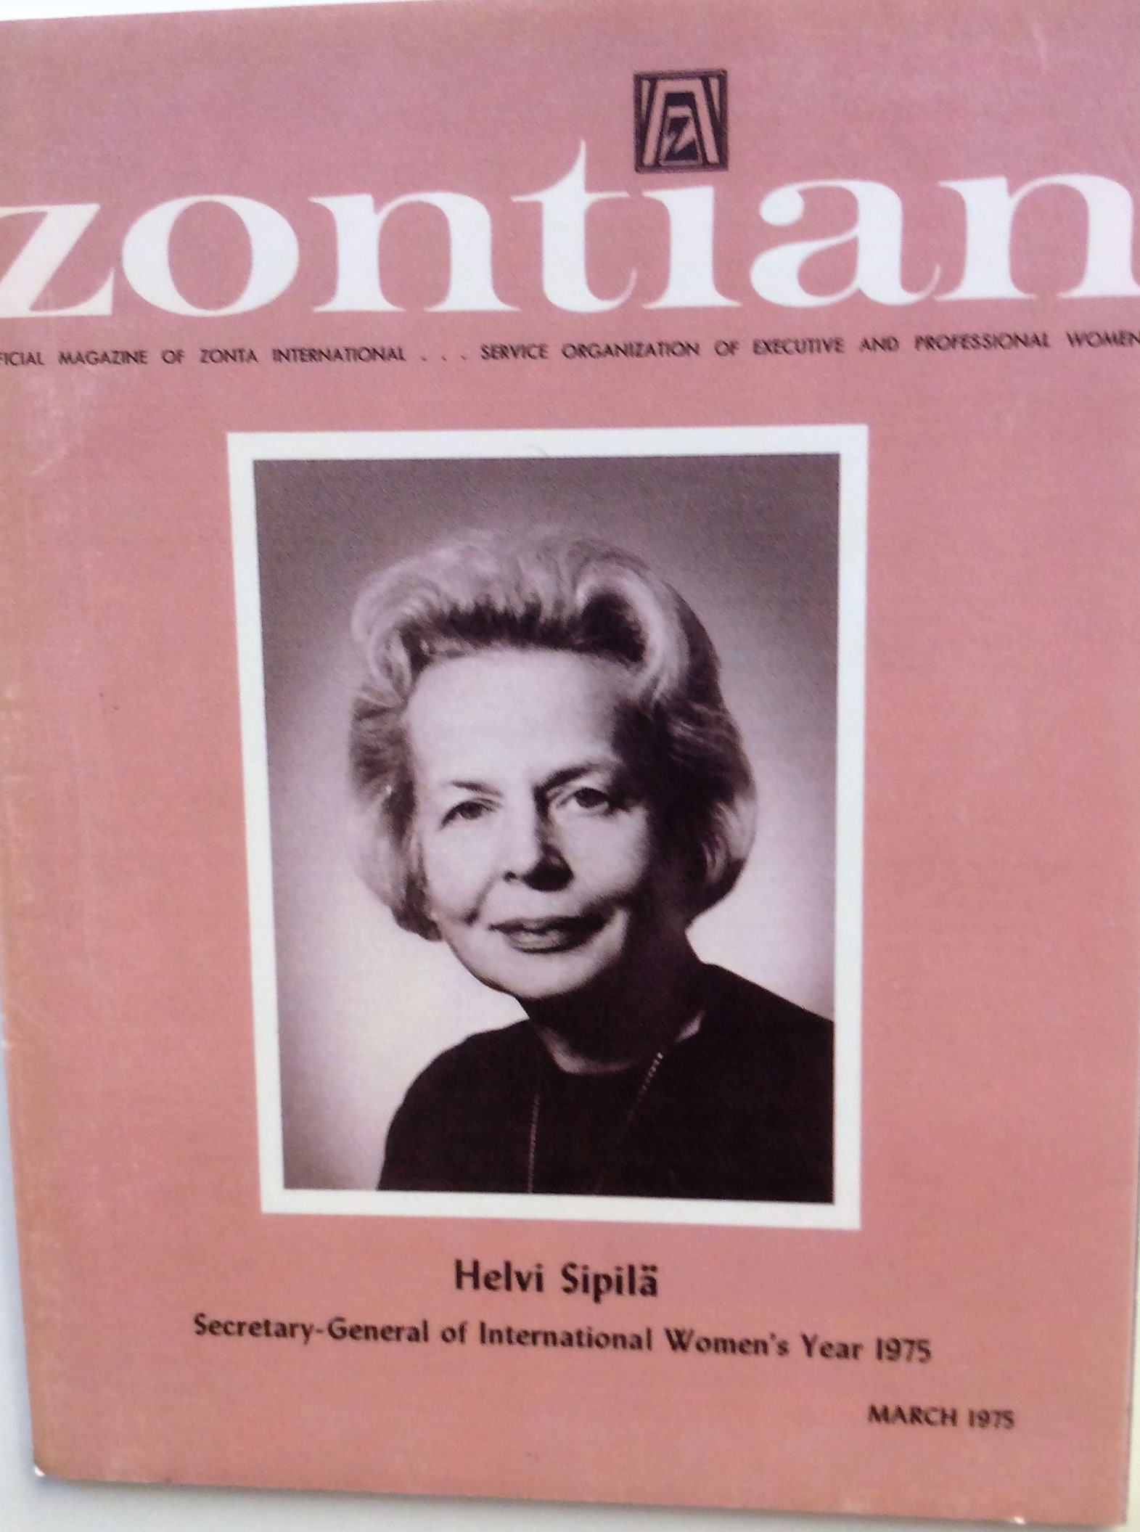
THE ZONTIAN

Slide 8
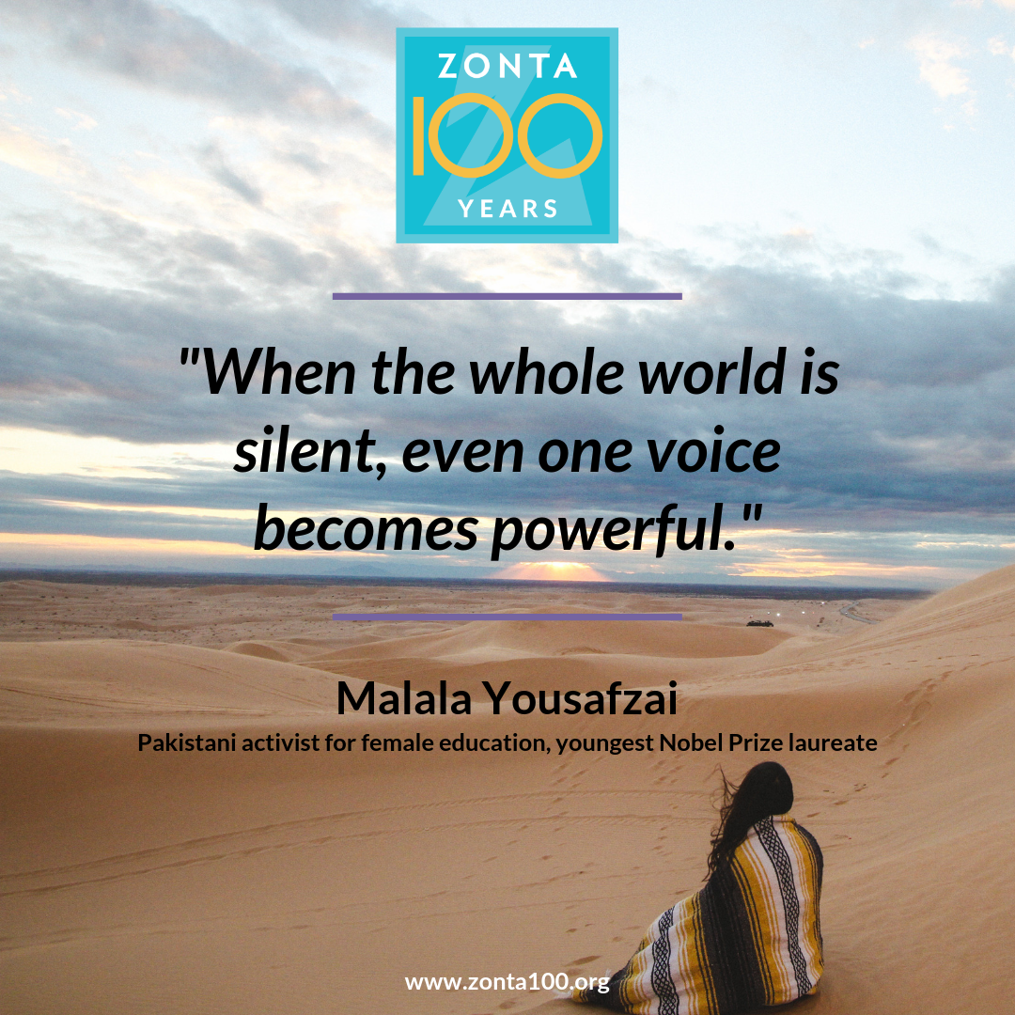

Slide 9
DISTRICT 3 AT CONVENTIONS

Slide 12
2016 ITALY

Slide 13
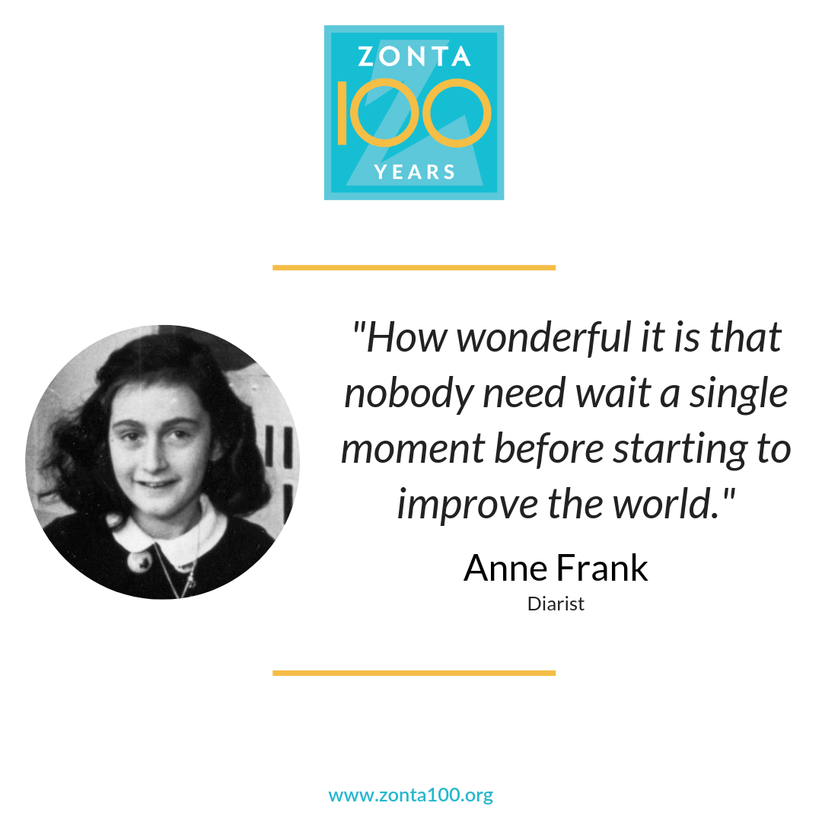

Slide 14
2014 ORLANDO, FLORIDA

Slide 16
AREA 1
BROOKLYN
GREATER QUEENS
LONG ISLAND
NEW ROCHELLE
NEW YORK CITY
PECONIC BAY
SUFFOLK COUNTY
WESTCHESTER COUNTY

Slide 17
BROOKLYN CLUB

Slide 18
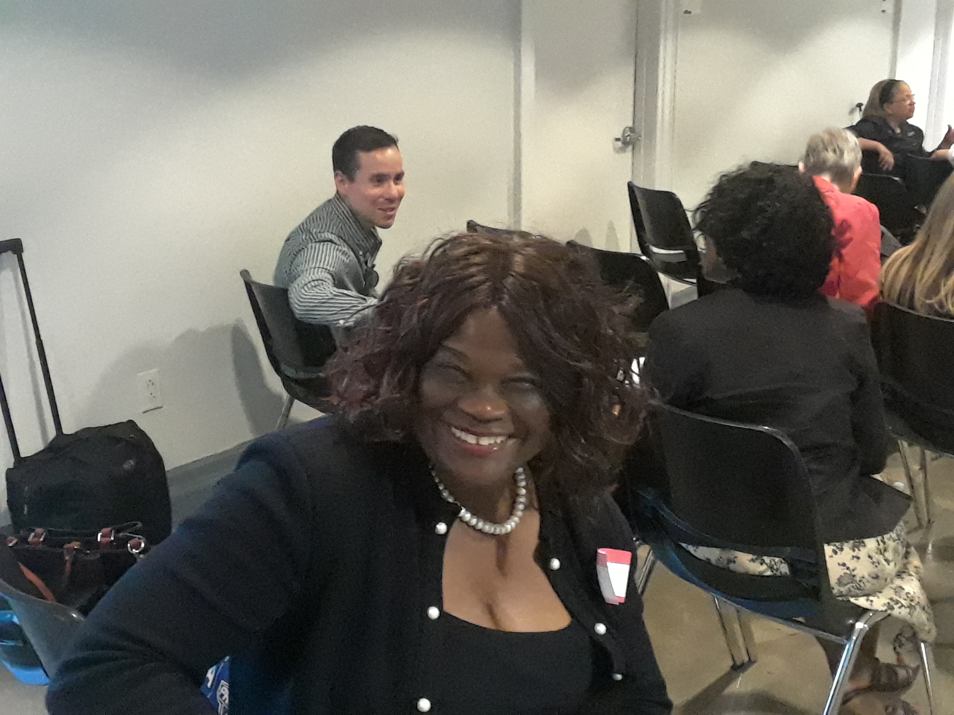

Slide 19
GREATER QUEENS CLUB

Slide 21
LONG ISLAND CLUB

Slide 22
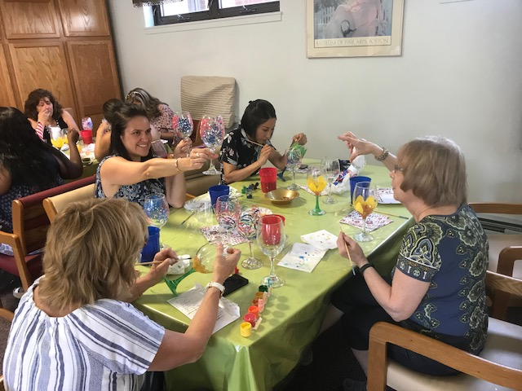

Slide 23
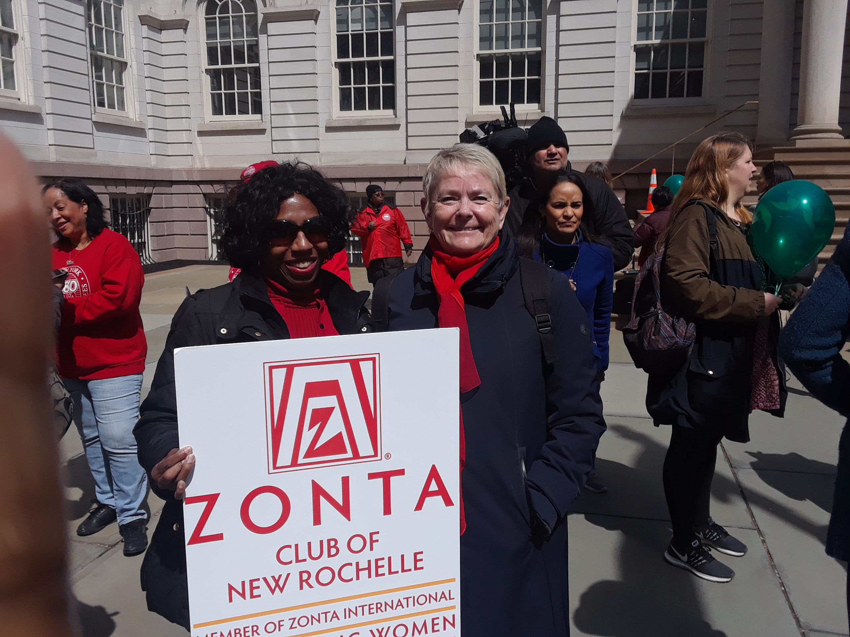
NEW ROCHELLE CLUB

Slide 24
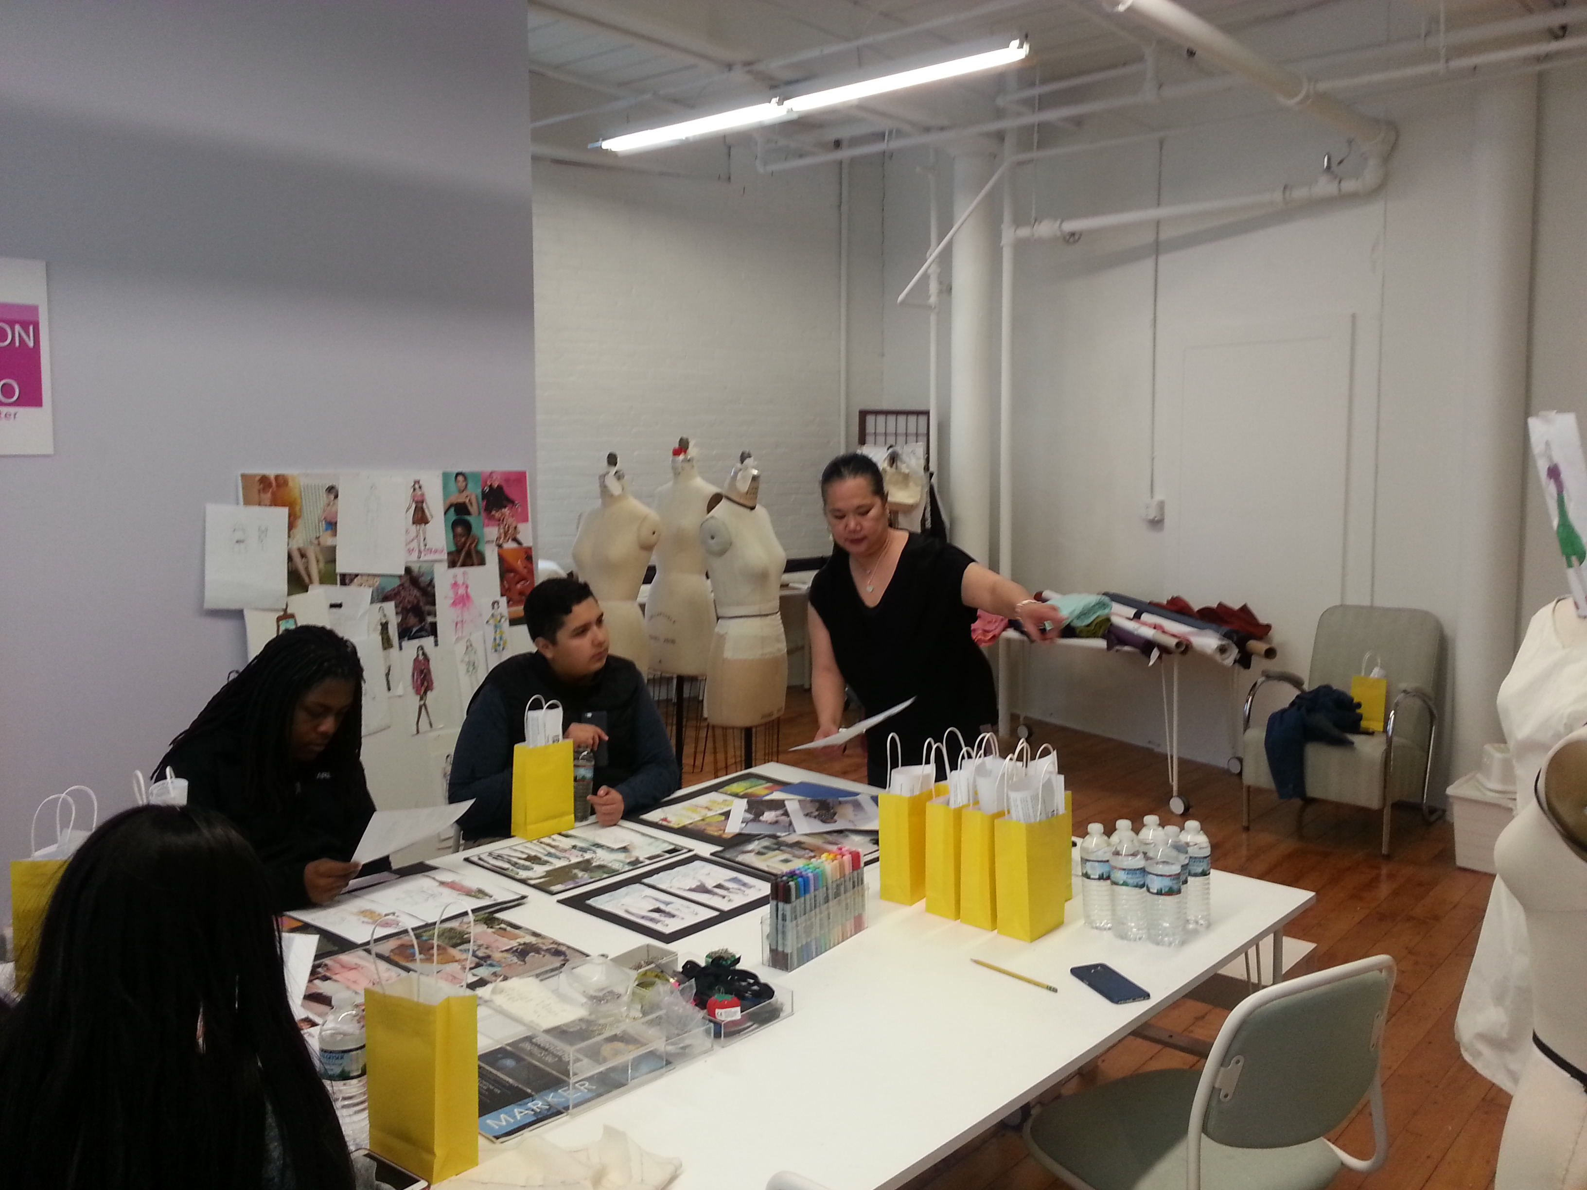

Slide 25
NEW YORK CITY CLUB

Slide 27
PECONIC BAY CLUB

Slide 29
SUFFOLK COUNTY CLUB

Slide 31
WESTCHESTER COUNTY CLUB

Slide 32
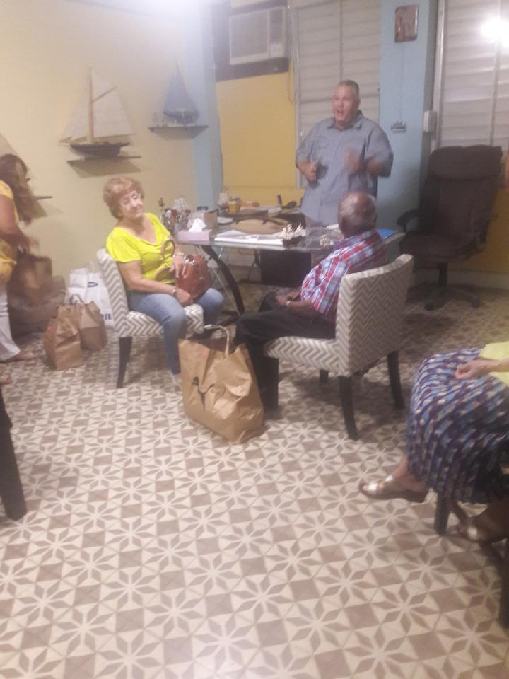

Slide 33
AREA 2
ESSEX COUNTY
MORRISTOWN AREA
NORTHERN VALLEY
RINGWOOD
PASSAIC-CLIFTON
SOUTHERN OCEAN COUNTY
TRENTON /MERCER

Slide 34
ESSEX COUNTY CLUB

Slide 36
MORRISTOWN AREA CLUB

Slide 37
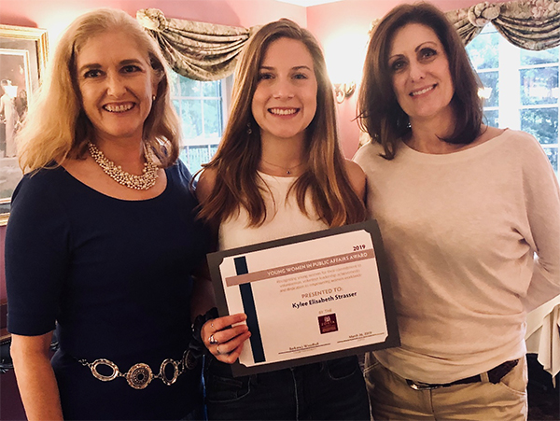
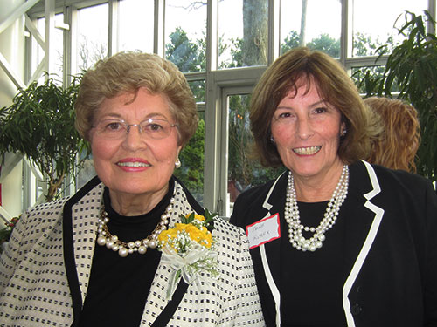

Slide 38
NORTHERN VALLEY CLUB

Slide 39
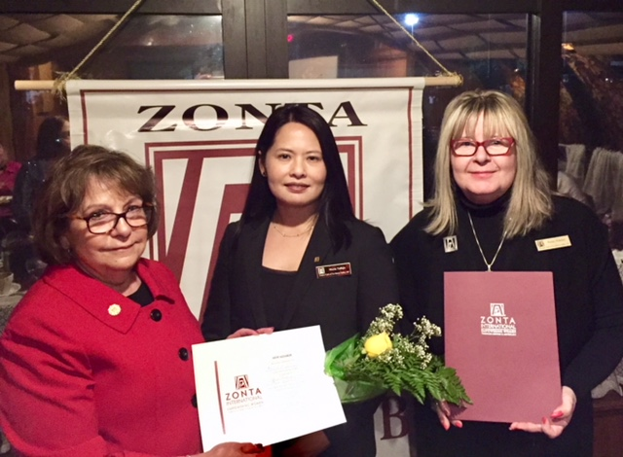

Slide 40
RINGWOOD CLUB

Slide 41
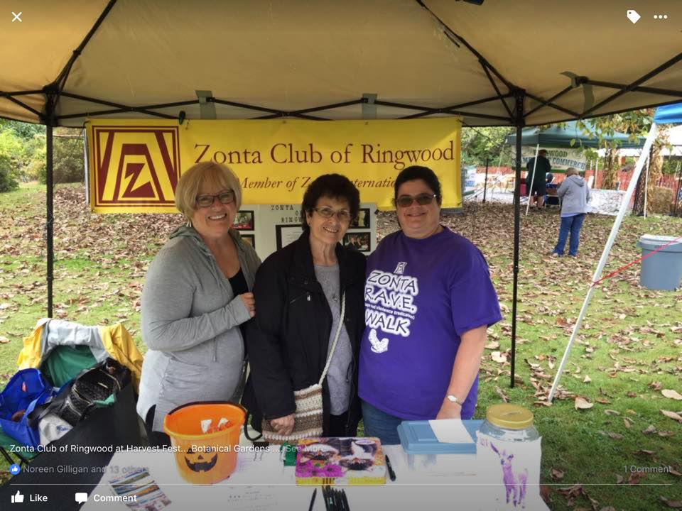
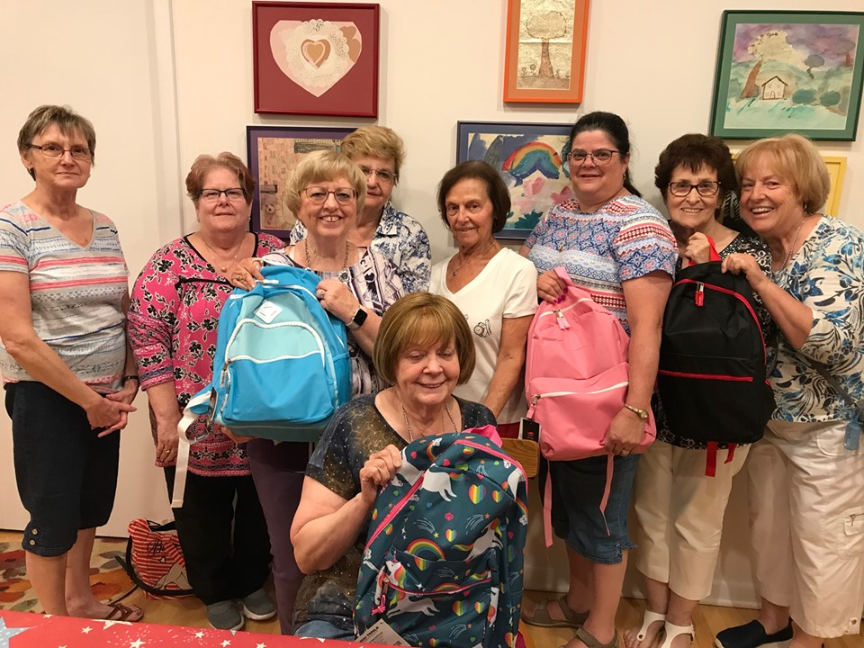

Slide 42
SOUTHERN OCEAN COUNTY CLUB

Slide 43
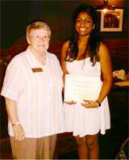
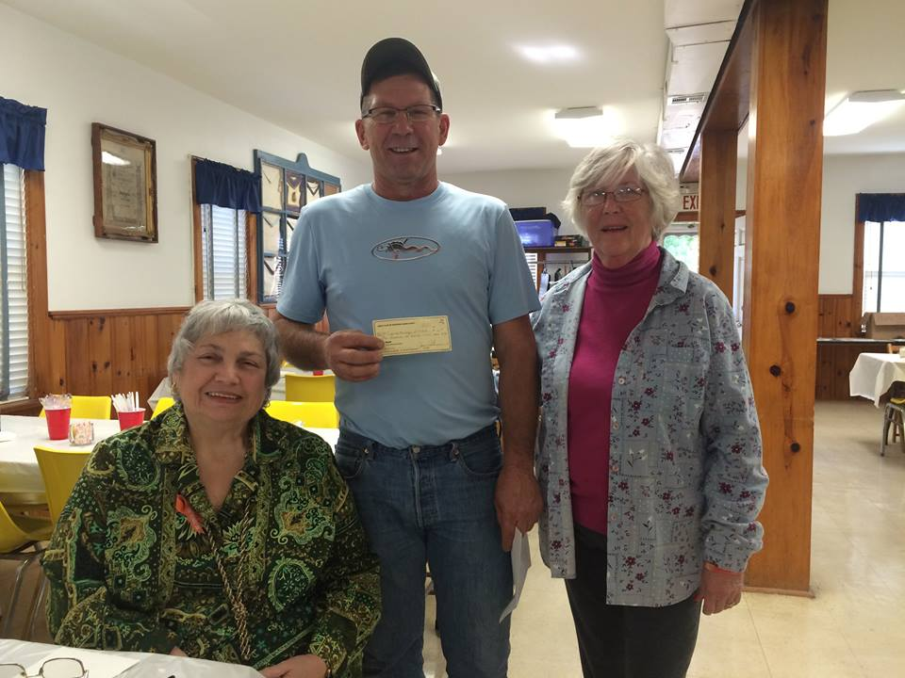
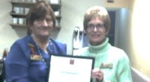

Slide 44
TRENTON/MERCER CLUB

Slide 45
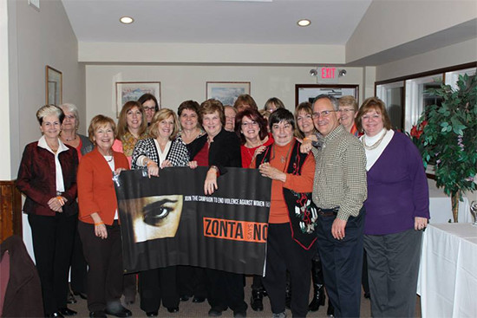
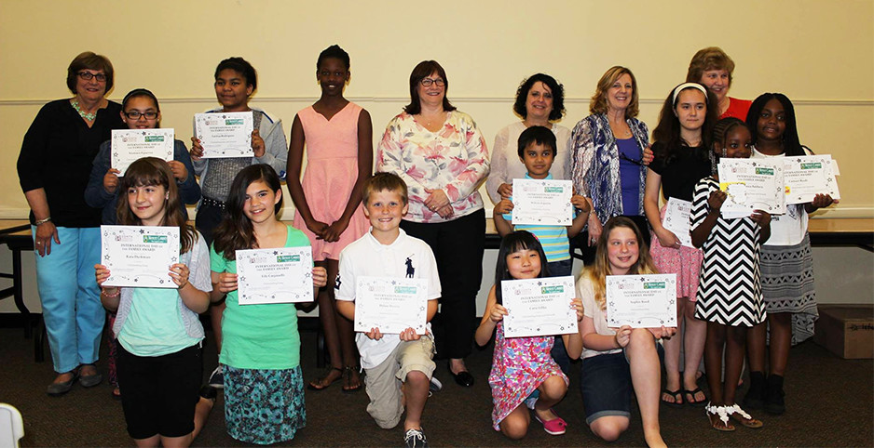

Slide 46
AREA 3
ANNAPOLIS
CUMBERLAND COUNTY
FREDERICK
HARRISBURG-HERSHEY
HOWARD COUNTY
MID-MARYLAND
PHILADELPHIA
TRI-COUNTY AREA

Slide 47
ANNAPOLIS CLUB

Slide 48
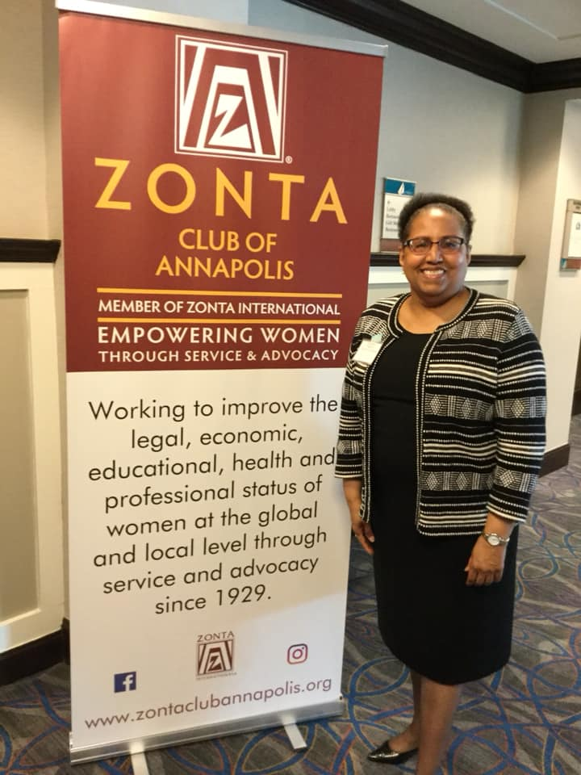
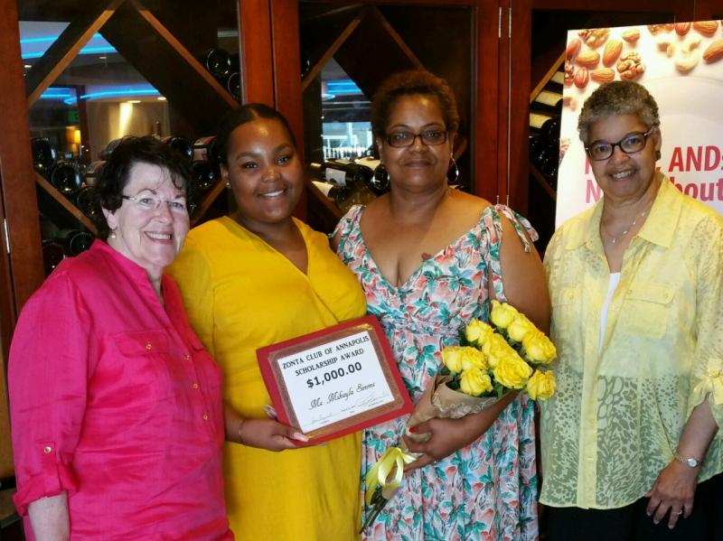

Slide 49
CUMBERLAND COUNTY CLUB

Slide 50
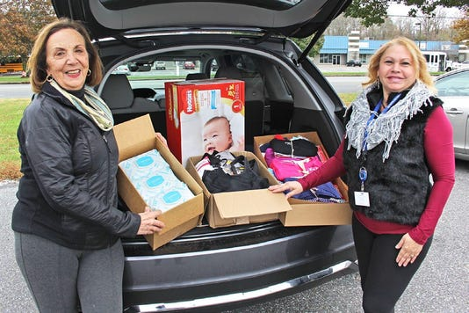
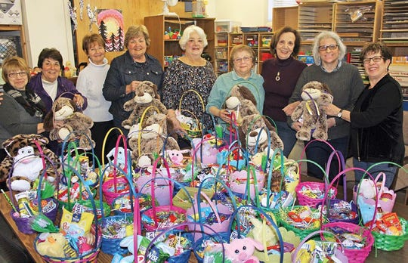

Slide 51
FREDERICK CLUB

Slide 52
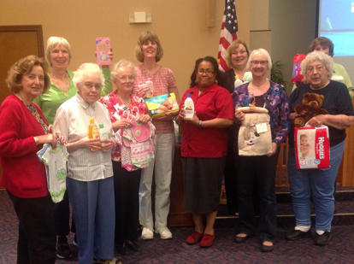
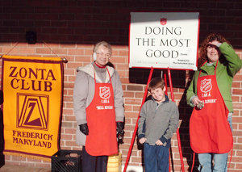

Slide 53
HARRISBURG HERSHEY CLUB

Slide 55
HOWARD COUNTY CLUB

Slide 56
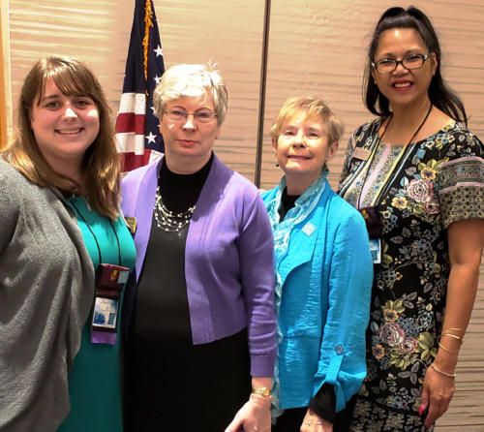

Slide 57
MID-MARYLAND CLUB

Slide 58
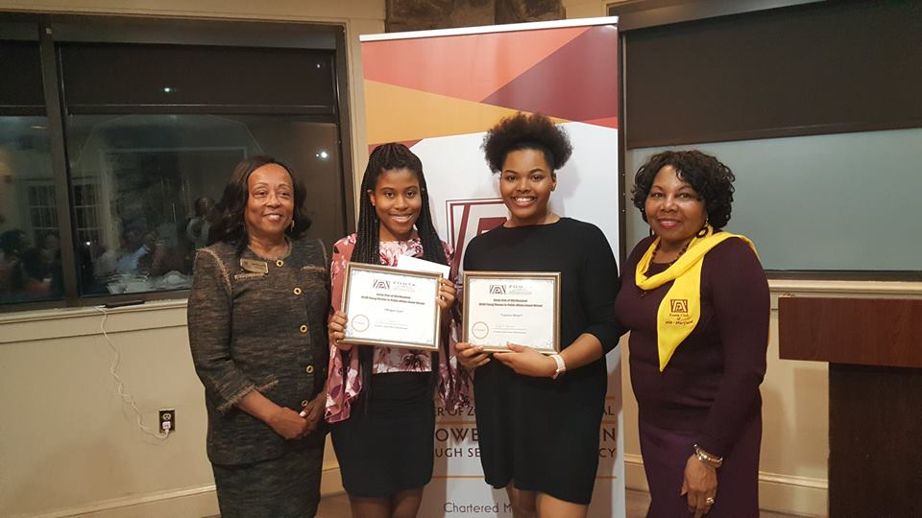
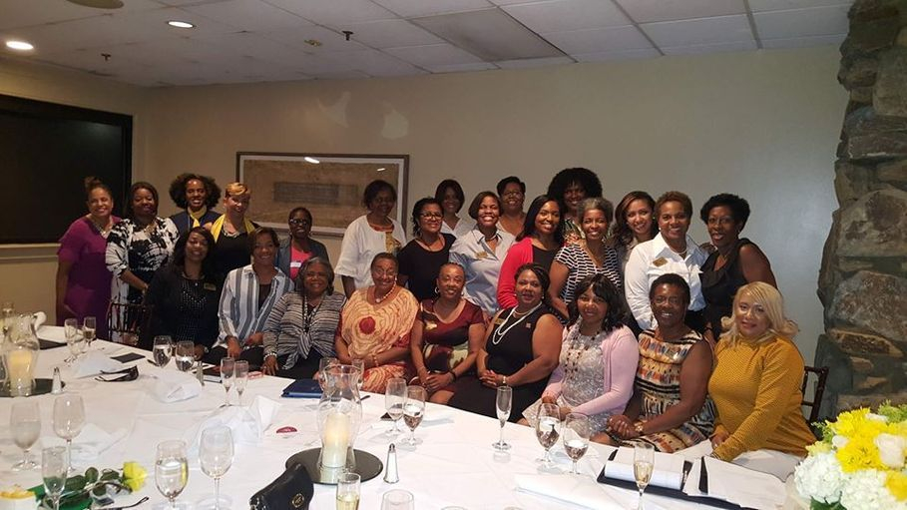

Slide 59
AREA 4
ARLINGTON AREA
CHARLES COUNTY
FAIRFAX COUNTY
HAMPTON ROADS
PRINCE GEORGE’S COUNTY AREA
WASHINGTON

Slide 60
ARLINGTON CLUB

Slide 62
CHARLES COUNTY CLUB

Slide 63
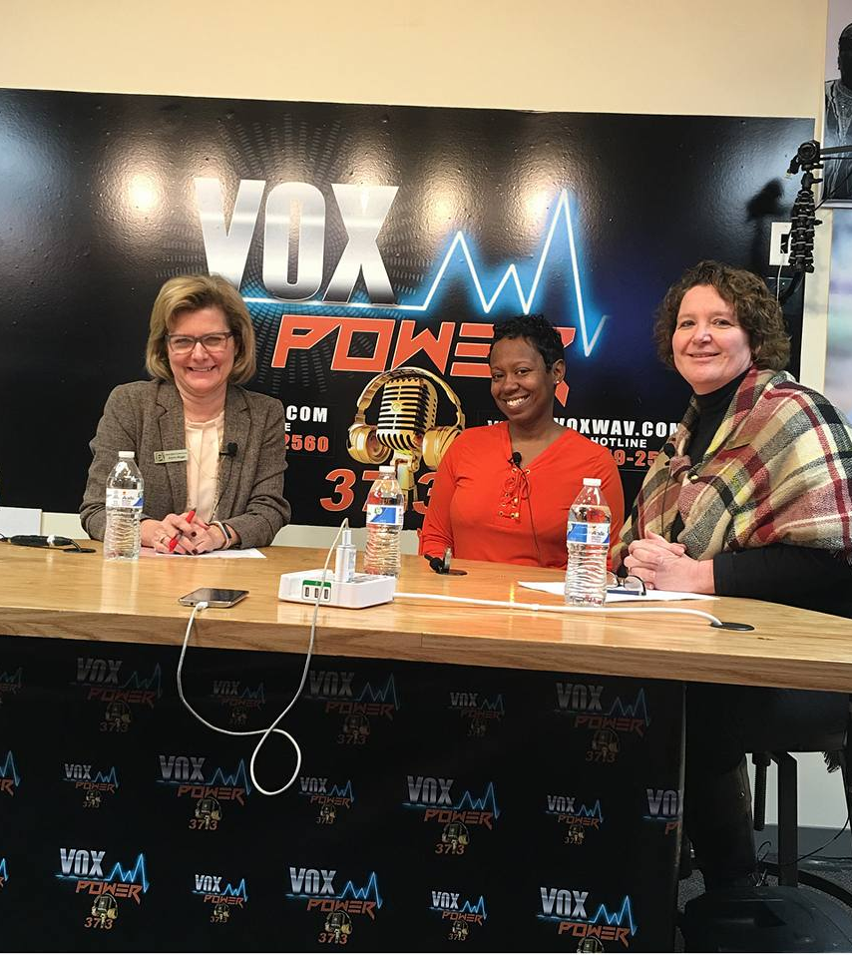

Slide 64
FAIRFAX COUNTY CLUB

Slide 66
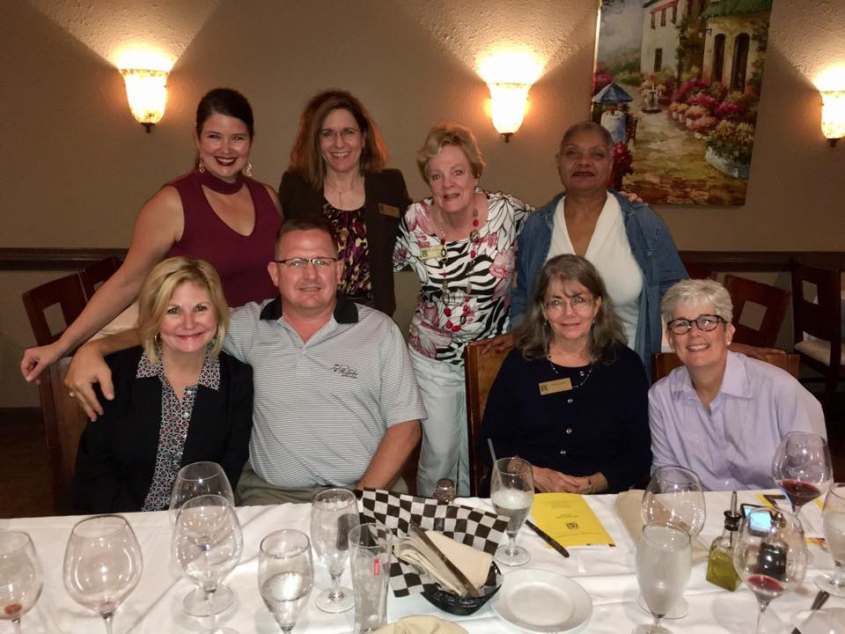
HAMPTON ROADS CLUB

Slide 67
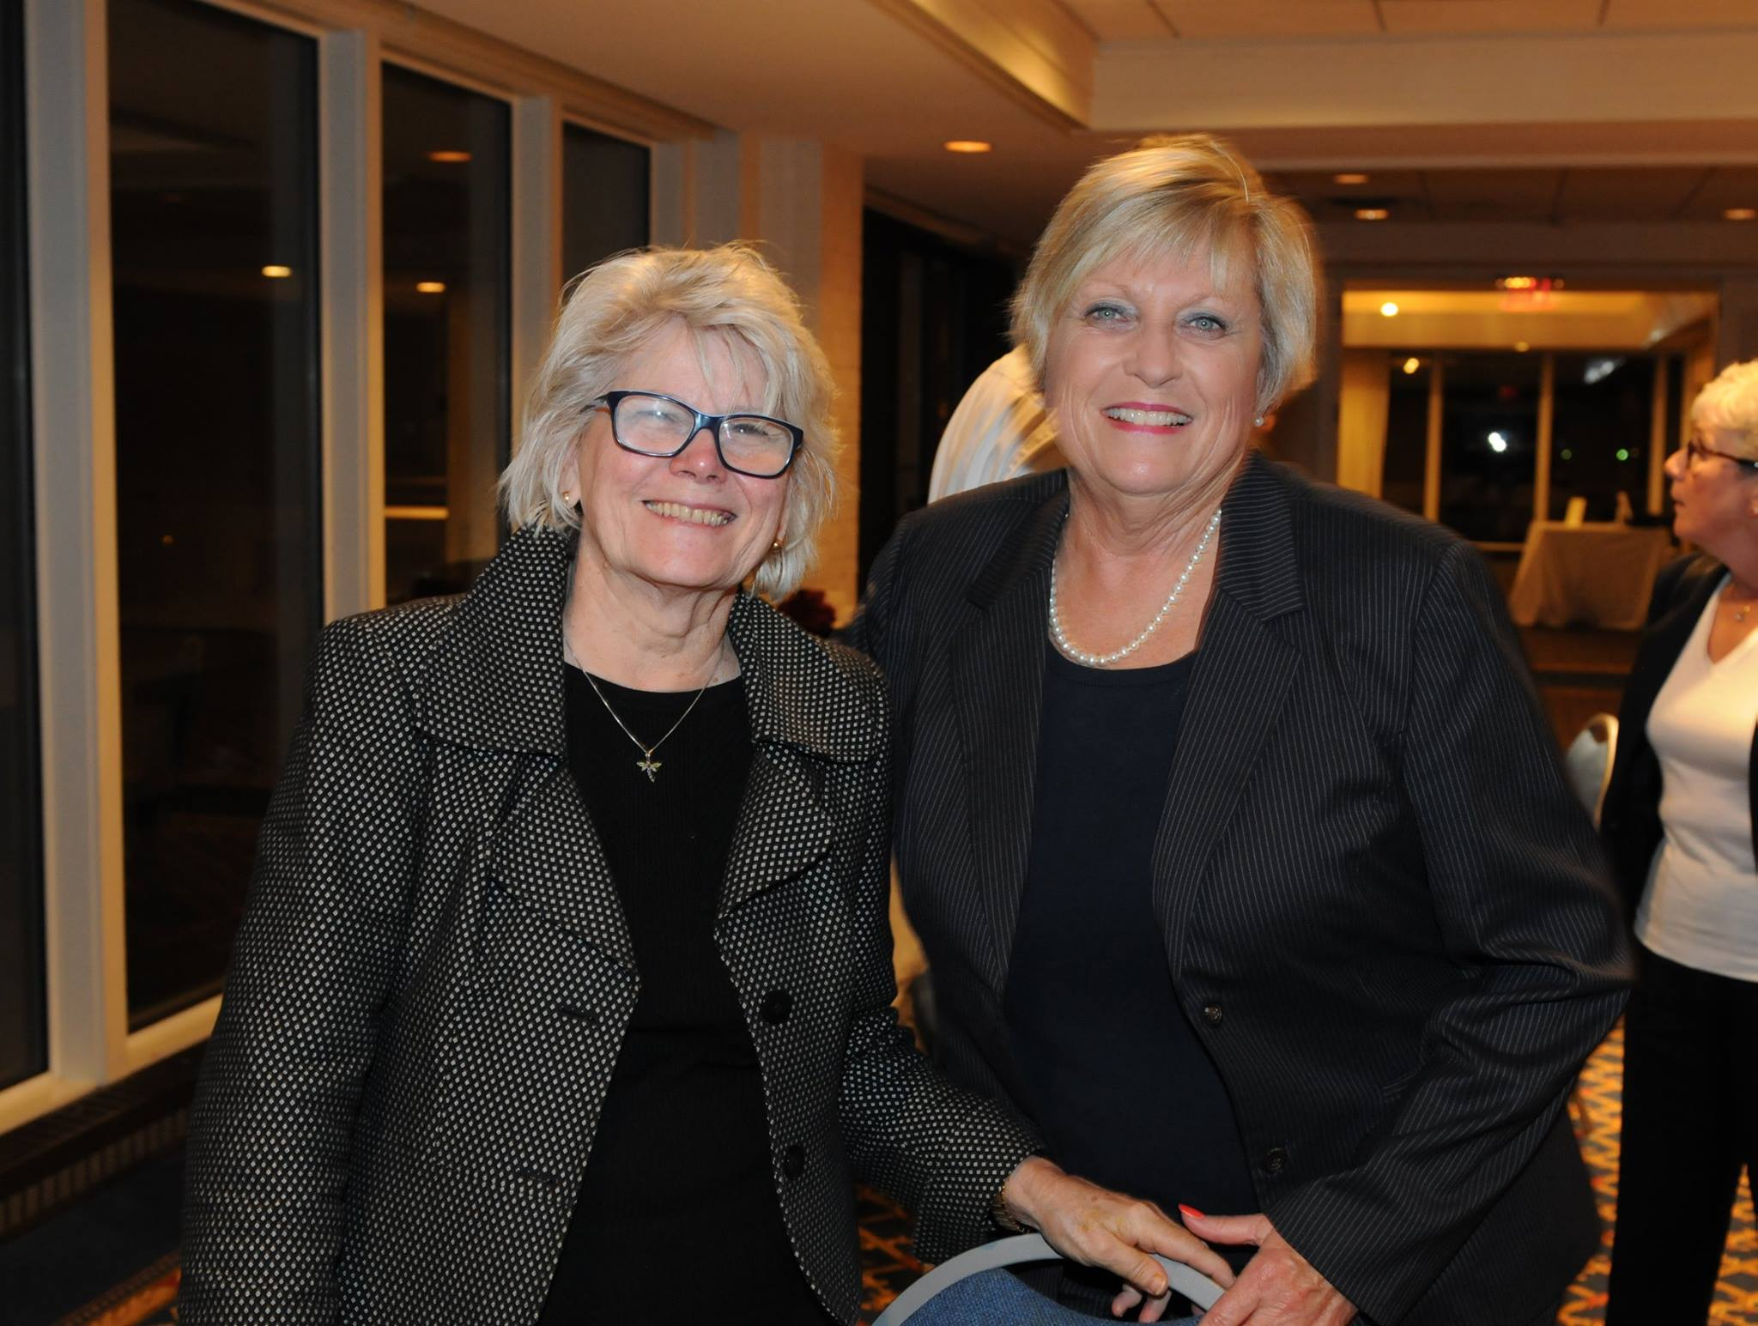

Slide 68
PRINCE GEORGE’S COUNTY AREA CLUB

Slide 70
WASHINGTON CLUB

Slide 72
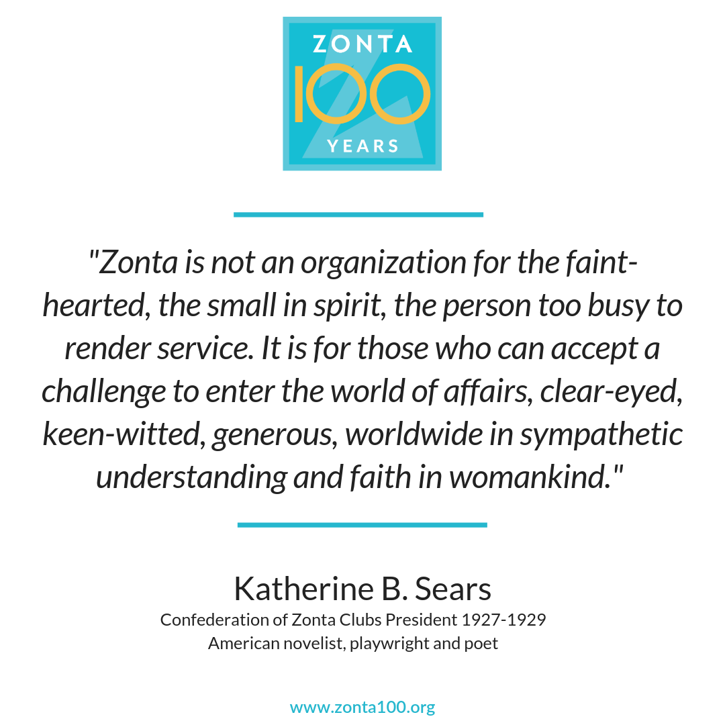

Slide 73
WE ARE DISTRICT 3!

Slide 74
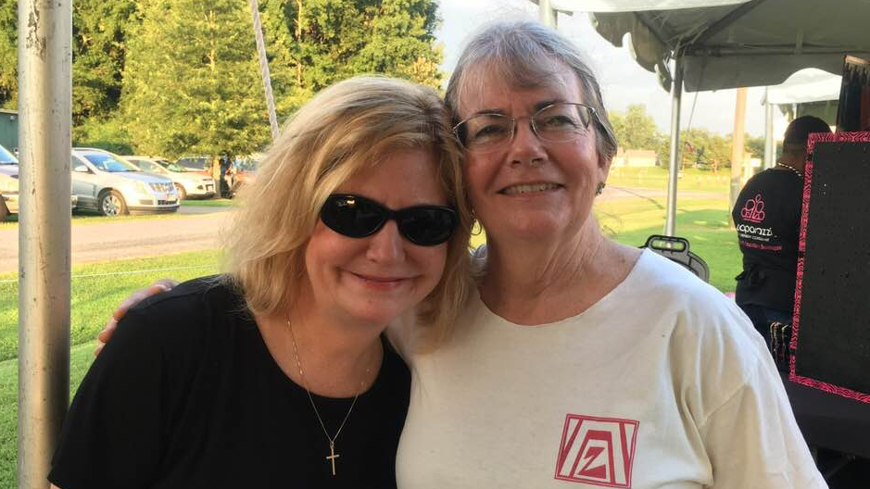

Slide 87
