Slide 1
Foundation Ambassador Presentation
2018-2020 Biennium
District 3 Governor’s Seminar
October 6, 2018
Notes:
Thank you for giving me the opportunity to speak to you today. I would like to tell you about the Zonta International Foundation, our goals for the current biennium and how your contributions help Zonta empower the lives of women and girls around the world.

Slide 2
Zonta International Foundation Funding
Friends of Zonta
Zonta
Clubs
Funds the charitable and education programs of Zonta International.
Contributions go entirely to program support and implementation.
Zonta International membership dues support Zonta International Foundation operating expenses.
Zonta Members
Notes:
Because dues paid to Zonta International support the operating costs of the Foundation, all of the contributions made to the Foundation can go directly to support programs.
Dues are not donations.
The Foundation’s revenues come from donations from Zonta clubs, Zontians and friends of Zonta. Clubs are strongly encouraged to give at least 1/3 of the funds raised locally to the Zonta International Foundation, keeping up to 2/3 for local service programs.

Slide 3
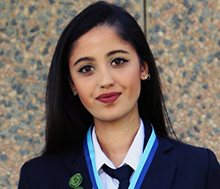
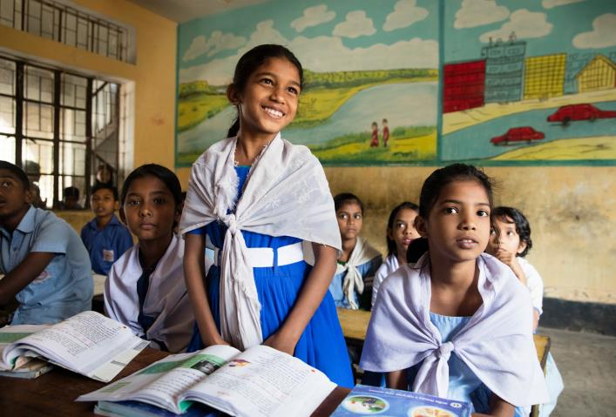
What Is New This Biennium?
Ending Child Marriage
$2 million funding for programming in 12 countries
Education Program Updates
Jane M. Klausman Women in Business scholarships and Young Women in Public Affairs awards will be paid for by money donated in this biennium and already existing funds that we put to good use
Pilot project: Women in Technology Scholarships
Mary E. Jenkins 1919 Society Update
We will promote the opportunity and the value of donating high-impact legacy gifts.
Courtesy of UNICEF
Notes:
By adopting the “Ending Child Marriage” service project, the Zonta International Foundation has committed to the largest funding goal of any service project in a singular biennium. By combining donations to the proposed project with service and advocacy activities at district and club levels, “Ending Child Marriage” will have the potential to become a signature initiative for Zonta International.
Changes have been made to the fundraising goals of the Jane M. Klausman Women in Business Scholarship Fund and Young Women in Public Affairs Award Fund. We will be raising less than we are distributing and using money in each fund we have already raised. This has been decided for two reasons:
We are putting the unspent money that was previously dedicated to these programs to good use
We are able to keep the overall fundraising goal at $5 million, with respect to the many financial efforts that will be made by our members during the Centennial biennium
As a pilot project, we will launch the Women in Technology Scholarship program that encourages women in technology to become leaders in this field, and ask all districts to implement it
As part of the biennial goals, the Foundation is looking to grow the Mary E. Jenkins 1919 Society by an additional 150 people. This is the our first real promotion encouraging Zonta supporters to include provisions in their estate plans to support the Zonta International Foundation.

Slide 4
2018-2020 Fundraising Goal
Fundraising Goal = US$5,000,000
Fund | Agency Partner | Title | Proposed USD
Zonta International Strategies to End Violence Against Women |  | Ending Child Marriage: A Program to Accelerate Global Action | 2,000,000
International Service Project |  | Eid bi Eid (Hand in Hand) Jordan | 1,000,000
International Service Project |  | Let Us Learn Madagascar: An Integrated Program for Adolescent Girls | 1,000,000
 |  | Amelia Earhart Fellowships | 600,000
 |  | Jane M. Klausman Women in Business Scholarships (with an additional $124,000 from the JMK Women in Business Fund; proposed total funding: $224,000) | 100,000
 |  | Young Women in Public Affairs Awards (with an additional $76,000 from the YWPA Award Fund; proposed total funding: $176,000) | 100,000
 |  | Rose Fund | 200,000
 |  | Total | 5,000,000
Notes:
For the 2018-2020 Biennium, the goal was proposed as US$5 million. The goal was set by the then president-elect and approved by the Zonta International Foundation Board. The projects were adopted at convention. By adopting the programs, clubs are committing to funding the them. We raise funds to support the programs of the current biennium. If we do not raise the full amount, we have to use reserves. It is important that we do not rely on the reserves and raise the money in the current biennium. The Rose Fund is our unrestricted fund that is used to complete the funding of the other funds at the end of the biennium. It is always okay to go over this budgeted amount.
Zonta will continue its support for the “Let Us Learn” program in Madagascar in partnership with UNICEF USA. Zonta has committed to a major new initiative with UNICEF USA to support the UNICEF/UNFPA global program to end child marriage, which will reach 2.5 million girls across 12 countries. Zonta has also committed its support to a project to help Syrian refugee and Jordanian women in Jordan through a partnership with long-time partner, UN Women.
Together with the education programs, the fundraising goal is a decrease of $376,000 compared to 2016-18. During the Centennial Anniversary biennium, individuals and clubs will be engaged in many activities, so the fundraising goal should not be perceived as a burden.
Each of the projects will provide agreed upon updates.

Slide 5
Zonta International Strategies to End Violence Against Women: Ending Child Marriage
Strengthen the critical institutions and systems in 12 countries to engage girls at risk of child marriage through targeted initiatives, including life skills, health information, economic empowerment and social protection.
Goals:
Building the skills and knowledge of girls at risk of child marriage
Support households in demonstrating positive attitudes toward adolescent girls
Strengthening the systems that deliver services to adolescent girls
Ensuring laws and policies protect and promote adolescent girls’ rights
Generating and using robust data to inform programs and policies relating to adolescent girls
Project’s initial phase has the potential to directly reach 2.5 million girls across 12 countries.
Commitment: US$2 million
Notes:
Worldwide, almost 650 million women alive today were married before their 18th birthday and an estimated 280 million more girls are at risk of becoming brides. If current trends continue, the number of girls and women married as children will reach nearly 1 billion by 2030.
Child marriage is a global violation of human rights that can be found in all cultures, religions, ethnicities and countries around the world. Recognizing that only a long-term strategy will ensure the desired outcomes, UNICEF and UNFPA have joined forces and formally launched a multi-country initiative to protect the rights of millions of the world’s most vulnerable girls. The Global Programme to Accelerate Action to End Child Marriage brings together governments, civil society, families and young people in a collective effort to prevent girls from marrying too young and to support those already married as girls.
Building upon the successful project in Niger last biennium, Zonta International has committed US$2,000,000 to UNICEF USA to support the UNICEF/UNFPA Global Programme to Accelerate Action to End Child Marriage in 12 countries: Bangladesh, Burkina Faso, Ethiopia, Ghana, India, Mozambique, Nepal, Niger, Sierra Leone, Uganda, Yemen and Zambia. Seven of these are Zonta countries. Zonta is the first private sector donor to the Global Programme to Accelerate Action to End Child Marriage.
The program is turning commitment into tangible action to effect meaningful and lasting change in girls’ lives by focusing on the five main strategies listed. Under the umbrella of these strategies, each country will have specific strategies that respond to the context and factors that lead girls into early marriage.

Slide 6
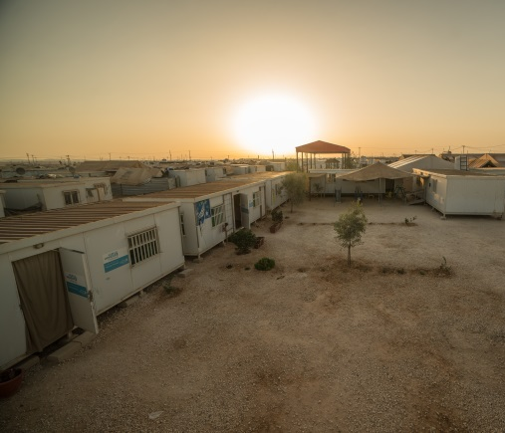
International Service Program: Eid bi Eid (Hand in Hand)
UN Women Jordan
UN Women/Christopher Herwig
A program to improve the resilience and empowerment of Syrian refugee and vulnerable Jordanian women.
Goal: Improve Syrian refugee and Jordanian women’s access to sustainable and decent employment, coupled with protection services and community engagement, to enable greater equality and reduced violence against women.
There are expected to be at least 25,760 direct beneficiaries from this initiative; which includes providing decent work opportunities to 300 Jordanian and Syrian women, remedial education services and child care facilities.
Commitment: US$1 million
Notes:
Jordan is currently hosting 1.4 million Syrian refugees which has increased competition over resources, placed additional strain on social services and heightened community tensions in some areas with unintended consequences, including greater restrictions on women’s mobility.
Eid bi Eid [pronounced eyed be eyed] is a multi-year initiative to support the government of Jordan to address issues of employment and gender inequality, exacerbated by the impact of the Syrian refugee crisis. The project began in 2015 to support the immediate needs of refugee women and vulnerable Jordanian women affected by the crisis. The second phase, which began in 2017, utilizes a resilience framework for achieving gender equality and women’s empowerment goals and promotes individual and community ability to absorb shock. This is done through the provision of livelihoods opportunities and protection support for refugee women living in camp and non-camp settings, as well as Jordanian women living in hosting communities.
The program’s expected outcomes are:
Women in camp settings and host communities are empowered through money for work and increased access to longer term economic recovery and livelihood opportunities.
Women’s protection and access to justice is promoted to enable accountability and support them to serve as active members of their community.
Women participate in and inform community decision-making processes.
Duty-bearers are supported to create a greater enabling environment for women’s economic participation

Slide 7
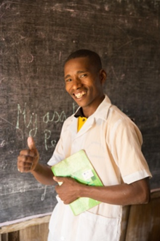
International Service Program: Let Us Learn Madagascar
Photos by: UNICEF Madagascar/2017/Abela Ralavita
The Let Us Learn initiative addresses education and gender inequity in Madagascar through approaches targeted toward adolescent girls.
Goals:
Ensure that more children, particularly girls (who drop out at higher levels in the post-primary level) have access to post-primary education and stay in school.
Ensure that Madagascar’s education system has the capacity to offer quality teaching for enhanced learning outcomes.
Commitment: $1million
Notes:
About 90 percent of Madagascar’s population lives on less than US$2 per day, leaving children particularly vulnerable. Aside from endemic poverty, Madagascar is prone to natural disasters, which further impede economic growth of the agricultural economy and make it even more difficult to escape poverty and prioritize education for children.
Let Us Learn is an integrated education program that is creating opportunities for vulnerable and excluded children, particularly girls, in Madagascar to realize their right to an education in a secure and protective environment. The project is focused on reaching out-of-school children, expanding girls’ education and improving quality outcomes for learners.
From 2016-2018, Zonta International contributed US$1,000,000 to UNICEF USA to support the Let Us Learn project. In July 2018, Zonta committed an additional US$1,000,000 to continue its support of Let Us Learn Madagascar through 2020.
The expected outcomes of the program are:
Approximately 200 children will benefit from newly constructed and equipped classrooms.
500 households will be reached with conditional cash transfers.
300 out-of-school girls will be reintegrated into school after attending catch-up classes.
Girls will benefit from menstrual hygiene management services.
960 at-risk girls and victims of violence and exploitation in schools and communities will benefit from either medical, legal or social support through a referral mechanism.
135 school directors will be trained, benefiting 41,516 children, of whom 21,006 are girls.

Slide 8
Amelia Earhart Fellowship Fund 2018-2020 Total Funding: US$600,000
30 fellowships of US$10,000 each
“Women have been making amazing strides so they can be taken for their skills and contributions rather than being identified as a woman first. I long for the day in which we would not pay attention to what sex we are (for statistics) but what we say and do.”
NASA
Dr. Kimberly Ennico Smith
1997-1998 Amelia Earhart Fellow
Co-Investigator and Deputy Project Scientist
NASA’s New Horizons Mission
Notes:
One of Zonta International’s longest-running programs is the Amelia Earhart Fellowship Program; this program is designed to expand opportunities for women in aerospace-applied sciences and aerospace-related engineering.
Since the program’s inception, Zonta International has awarded 1,573 Amelia Earhart Fellowships, totaling more than US$10 million, to 1,144 women from 73 countries.
At the November 2017 Board meeting, the Zonta International Board decided to decrease the number of Amelia Earhart Fellowships awarded annually from 35 Fellowships to 30 Fellowships. This change became effective with the 2018 Amelia Earhart Fellowships which were announced in May 2018. The amount of the Fellowship, US$10,000, remains the same.

Slide 9
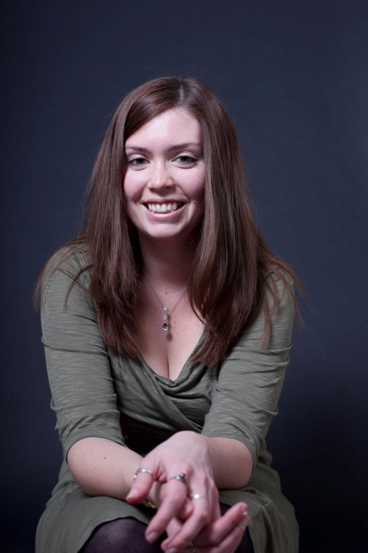
Jane M. Klausman Women in Business Scholarship Fund 2018-2020 Total Funding: US$224,000
6 international scholarships of US$8,000 each
32 district/region scholarships of US$2,000 each
“I am so proud to be a JMK International Scholarship alumnus. The award was incredibly helpful in
assisting me to complete my MBA program and
achieving my ambitions in aerospace business management and leadership. I am also very grateful
that the JMK award introduced me to Zonta
International. I am honored to be a member of the organization and participate in improving the status of women worldwide.”
Angela Whiteside, Founder & President of KickStage Consulting Inc.
2011 international JMK Women in Business Scholar
Member, Zonta Club of Newport Harbor
Notes:
The Jane M. Klausman (JMK) Women in Business Scholarship is for women of any age, pursuing a business or business-related program who demonstrate outstanding potential in the field and are living or studying in a Zonta district/region.
In 2017, 31 recipients from 17 countries demonstrated outstanding achievements and potential in business or a business-related field. Since the program's inception in 1998, Zonta has awarded 527 Scholarships, totaling more than US$1.2 million, to 397 women from 56 countries.
Zonta International also decided to decrease the number of international Jane M. Klausman Women in Business Scholarships awarded annually from 12 scholarships to six scholarships; however, the amount of each international scholarship will increase from US$7,000 to US$8,000. At the same time, Zonta International will increase the 32 district and region scholarships from US$1,000 each to US$2,000 each. By increasing the value of each scholarship, we hope to attract a greater number of very qualified applicants in every district.
Here we see one of our many successful scholars, Angela Whiteside. Originally from the United Kingdom, Angela currently lives in Huntington Beach, California with her husband, Zac, and 3-year old son Stellan. They have also recently completed the adoption of a 4-year old girl from Sierra Leone. Angela is founder and president of her own engineering consultancy company, KickStage Consulting Inc., that specializes in providing agile technical and supply chain management services to the aerospace and hi-tech industries. She is also an active member of the Zonta Club of Newport Harbor.

Slide 10
Young Women in Public Affairs Award 2018-2020 Total Funding: US$176,000
10 international scholarships of US$4,000 each
32 district/region scholarships of US$1,500 each
“I thank you, Zontians, for the
International Young Women in
Public Affairs Award. It means a lot
for me. Its significance is not only to
focus on what I have done, but to
encourage me, a young woman, to
go on and achieve more and to work
harder for important issues.”
Anna Rukko, 2015 YWPA Awardee at the 2016 Zonta International Convention in Nice, France
Notes:
The Young Women in Public Affairs Award recognizes young women for their commitment to the volunteer sector, evidence of volunteer leadership achievements and dedication to empowering women worldwide through service and advocacy. Since the program's inception, Zonta has given 888 awards, totaling US$924,750, to 756 young women from 56 countries.
Zonta International increased the 32 district and region Young Women in Public Affairs Awards from US$1,000 each to US$1,500 each. The number and amount of the international awards remains at 10 international scholarships of US$4,000 each.
In 2018, 32 exceptional applicants from 19 countries were considered in the final selection for the 10 international awards.

Slide 11
Women in Technology Scholarship
Fully funded pilot program
Awarded once in the 2018-2020 Biennium
Club: club award and amount determined by club
District/Region: 32 scholarships, US$2,000 each
International: 6 scholarships, US$8,000 each
wocintechchat.com
Notes:
The Zonta International Women in Technology Scholarship is a pilot program during Zonta’s centennial biennium that is designed to encourage women to pursue education and career opportunities in technology and to take on leadership roles in this field. The Zonta International Foundation Board has approved funding of US$112,000 to be disbursed from reserves in the Rose Fund. Because it is a fully funded pilot program, we are not currently raising any funds.
The program will operate at the club, district/region and international levels of Zonta International.

Slide 12
Mary E. Jenkins 1919 Society
What is a legacy gift?
A legacy, or planned gift, is a provision to leave part of your estate to the Zonta International Foundation. It can be a bequest of a specific amount, a percent of your assets, a life insurance policy, stocks, annuities or other financial instruments.
2018-2020 Goal
At least 150 new society members during the Centennial Anniversary Biennium.
Would you like to reserve your place in Zonta’s future?
Notes:
The Mary E. Jenkins 1919 Society was established for Zontians wishing to leave a legacy gift to ensure Zonta’s future. Through legacy or planned giving, donors are able to make a significant philanthropic commitment, and many donors find this option to be more comfortable than doing so during their lifetime. There are many types of planned and life-income gifts that can offer benefits to donors and their families, in addition to funding Zonta International's work.
Everyone who informs us of their provision of this kind automatically becomes a member of the Mary E. Jenkins 1919 Society.
Add your name to the growing list of Zontians who have already designated part of their estate to the Zonta International Foundation.
Each year, we honor those who are a part of the Mary E. Jenkins 1919 Society within our Annual Report.

Slide 13
Centennial Anniversary Grants
Opportunity to increase the impact of Zonta clubs working with partner organizations to improve women’s and girls’ lives locally
Increases the visibility of club projects and strengthens the link between Zonta’s local and international levels
Funded by the Rose Fund
Notes:
To celebrate our centennial anniversary, Zonta International will award Centennial Anniversary Grants to like-minded charity organizations who partner with a Zonta clubs. This will provide a great opportunity for Zonta clubs working with another charitable organization to directly improve women’s and girls’ lives in their community.
The Zonta International Service Committee will review applications and give their recommendations to the Executive Committee for final approval.
The maximum sum disbursed through this program will be US$300,000. The funding for these grants has been approved by the Zonta International Foundation Board with payments being disbursed from the Rose Fund reserves.
This special program is highlights the importance of donating to the Rose Fund, our unrestrictive fund, which is used to complete the funding of the other funds at the end of the biennium and supports the development of new initiatives.

Slide 14
Notes:
This is our current progress to our goal – Please update the graphic before each presentation. Email zifoundation@zonta.org for help.

Slide 15
Campaigns and Giving Opportunities
Zonta’s Birthday (8 November)
Zonta Says NO to Violence Against Women Campaign (25 November – 10 December)
Zonta Rose Day/International Women’s Day (8 March)
Annual Report recognition/end of fiscal year (31 May)
Convention recognition (30 April 2020)
Celebrating successful events or milestone anniversaries
Memorials when Zontians pass away
Notes:
Zonta solicits funding throughout the year via campaigns or appeals. No one is expected to participate in every campaign. Different appeals prompt action from different people.

Slide 16
Your Gift Makes a Lasting Difference
Meet Herisoa from Madagascar
UNICEF Madagascar/2017/Abela Ralavita
Notes:
This is Herisoa, a participant of the Let Us Learn Madagascar project. Herisoa was elected by her peers as president of her school’s club and leads anti-violence initiatives and promotes children’s rights in her village and in her school. Herisoa is described as a young leader that is very proud of her role as Club President. She wants to complete her education and continue to secondary school.
Through the Let Us Learn Madagascar program, she is provided with a school that is safely built and can withstand the regions extreme weather conditions, trained and supportive teachers, general school supplies.
By supporting Zonta International Foundation, we can help girls like Herisoa stay in school and release their full potential to impact their peers, families, and communities.

Slide 17
THANK YOU
Notes:
Thank you for all you do for Zonta and the Zonta International Foundation. Hopefully today’s presentation has helped you understand how your contributions help Zonta change the lives of women and girls around the world. Individually we can only do so much. Together we can change the world for other women. Thank you for contributing to the Zonta International Foundation!

