Slide 1
Zonta USA Caucus
Who we are, what we do and how we empower our districts
Bobbee Cardillo, District 3 Advocacy Chair

Slide 2
Zonta International Advocacy Committee USA Caucus
What is it?
Zonta clubs and districts in the U.S. united to support Zonta International’s mission to empower women and girls through service and advocacy.
Working under the direction of the International Advocacy Committee, the Zonta USA Caucus is a platform for advocacy actions within the U.S.

Slide 3
Who is in it?
One representative from each of the Zonta Districts in the U.S.
A total of 13 members.
The members of the International Advocacy Committee, based in the U.S., are ex-officio members of the Zonta USA Caucus.

Slide 4
What do we do?
Stay informed about federal and state legislation that impacts women.
Select women’s issues to work on, based on ZI’s broad mission and specific goals.

Slide 5
How do we do it?
Committee members work on staying informed about federal and state legislation related to each issue;
Work to find potential partners working towards the same issue/goal; and
Share the relevant information at the meetings for discussion and approval (by vote).

Slide 6
How do we do it?
We have formed sub-committees to address the following issues:
  Equal Rights Amendment (ERA)
  Ending Child Marriage
  Human Trafficking
  Cities for CEDAW

Slide 7
So far, we have…..
Joined the ERA Coalition ,attend their meetings, and collaborate on ERA efforts in Virginia and Arizona.
Teamed up with Unchained At Last, for getting Child Marriage laws amended in the U.S.
Work with Cities for CEDAW, to provide a toolkit and support for promoting the tenets of CEDAW

Slide 8
We will…
Encourage Zonta members in the U.S. to get involved in local actions for advocacy.
Educate Zonta members about state and federal laws.
Continue to find partners for each of our causes, to strengthen our efforts.

Slide 9
We will…
Be an advocate for our districts and forward your ideas or concerns to the caucus.
Work with districts to implement advocacy actions at the state level including scripted day meeting suggestions.
Send out Action Alert emails to members to take action on an urgent issue.

Slide 10
We will…
Provide resources to clubs for conducting advocacy:
  Zonta USA Caucus Advocacy Tool Kit on the ZI website.
  Provides briefs on particular issues and guidance on conducting advocacy.

Slide 11
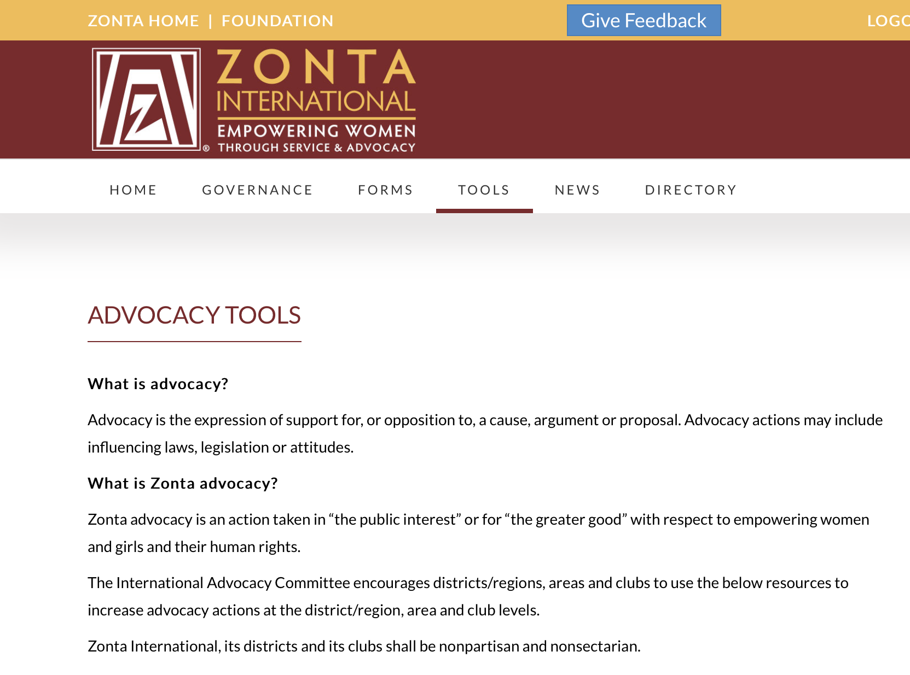
ZI Advocacy Tools

Slide 14
How you will talk about it…
Talk about an issue from the heart
Say it with a theme – “The ERA means Equal Pay for All”
Say it with a personal story
Tell the message from a renowned advocate
Pictures are worth a thousand words

