Slide 2
Credentials Committee gave a daily report of attendance
International Board 11
Past International Presidents 7
Governors 31
Delegate and Proxy Votes 1418
Total Number of Votes 1467
Total Number of Countries 66 (Mongolia the latest)
Total Number of Clubs 1159
Clubs Represented by Delegates 664
Clubs Represented by Proxy 423
Clubs Not Represented 72
Zonta Members Registered 2037
Guests Registered 280
Total Attendees at Convention last day 2366

Slide 3
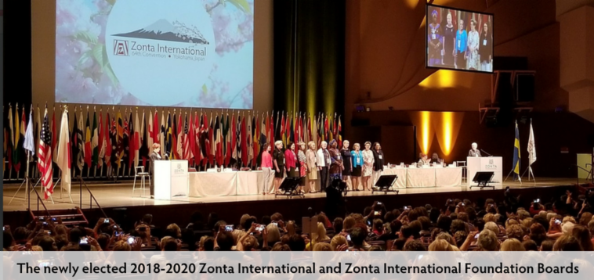
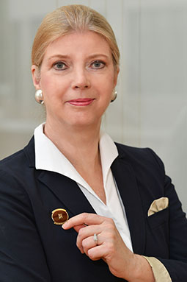
SUSANNE von BASSEWITZ
Düsseldorf II, Germany District 29
2018-2020 Zonta International and Zonta International Foundation Boards:
International Nominating Committee:
North, Central and South America
Denise Quarles
Europe
Dietlind Stuerz
Africa
Anne-Marie French Cudjoe
Australia and New Zealand
Janet Hope
Asia
Dilruba Ahmed
At Large
Sonia Albanese
Judith Anderson
Sonja Hönig Schough
Dunstanette Macauley
President-Elect: Sharon Langenbeck
Vice President: Ute Scholz
Treasurer/Secretary: Mari McKenzie
International Directors:
Marguerite Akossi-Mvongo
Margaret Bateman
Sigrid Duden
Judy Gorton
Lalivan Karnchanachari
Christina Rylander Bergqvist
Salla Tuominen

Slide 5
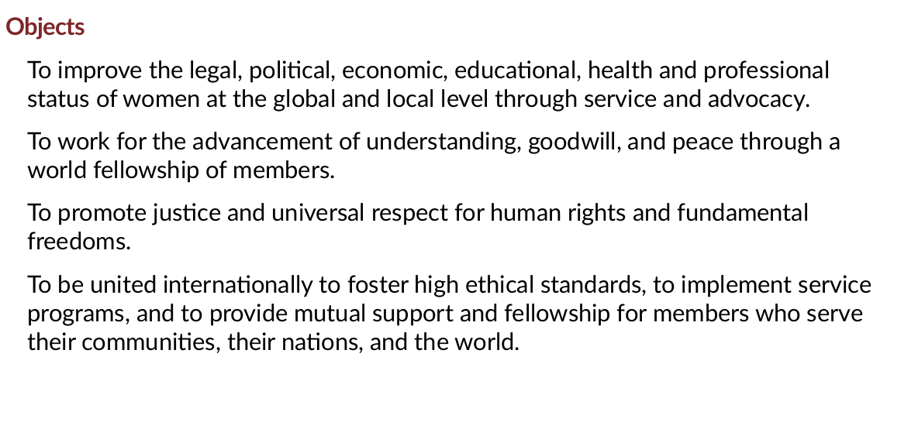

Slide 6
Zonta International
Zonta International 2018-2020 Biennial Goals
We empower women
Goal 1
We maximize our impact through service and advocacy initiatives and educational programs that empower women and girls
Goal 2
We strengthen our resources to support our mission
Goal 3
We enhance our profile around the world through centennial anniversary activities

Slide 7
By-Laws changes affecting District and Clubs
Diversity of Membership
Member classifications on the website: www.zonta.org/membership tools/membership planning
ZI Termination of clubs if club failed to pay dues or do not meet at least quarterly or do not function as a Zonta club
ZI Dues and fees – ZI raised dues $8.00 starting in 2019. New members under 30 get 50% reduction of dues.
JMK remains the same name
YWPA – now includes Young Women Leaders in Public Affairs/Services
District Officers – take office at close of Convention. Term is 2 years. Treasurer eligible to serve in the same office (two terms, not necessarily consecutive); area directors eligible to serve again 4 years after completion of term.
https://membership.zonta.org/Governance

Slide 8
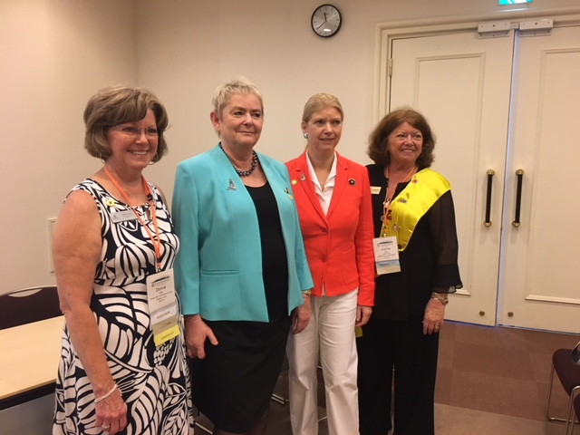
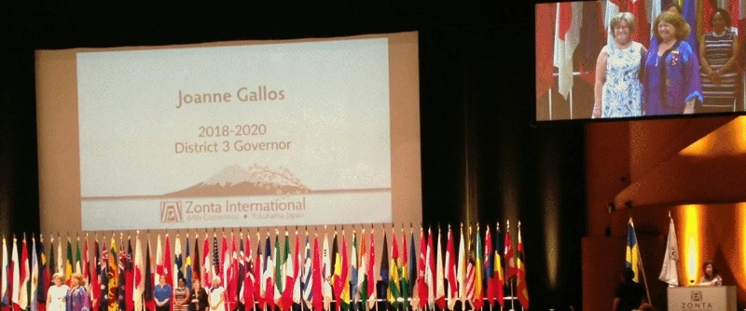
Outgoing & Incoming International President and District 3 Governor
Transition of District 3 Governor
for 2018-2020 Biennium

Slide 9
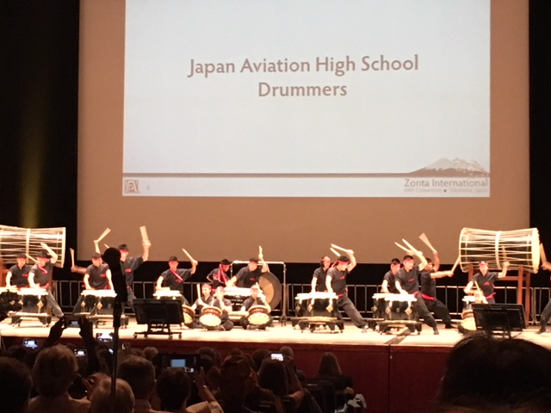
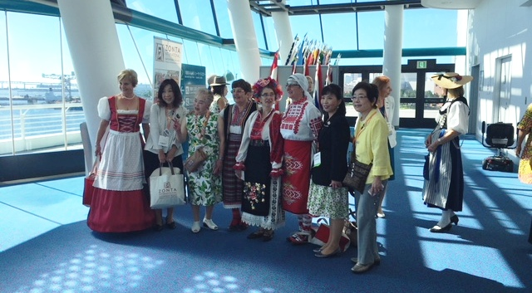
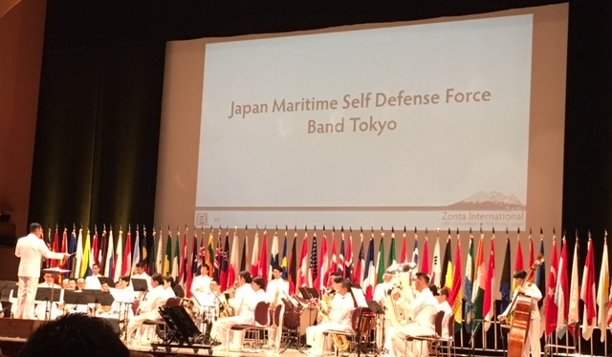
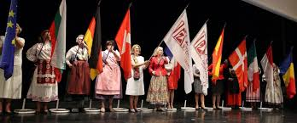
Yokohama Convention Highlights

Slide 10
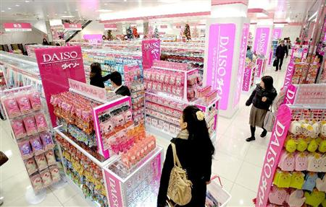
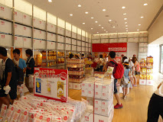
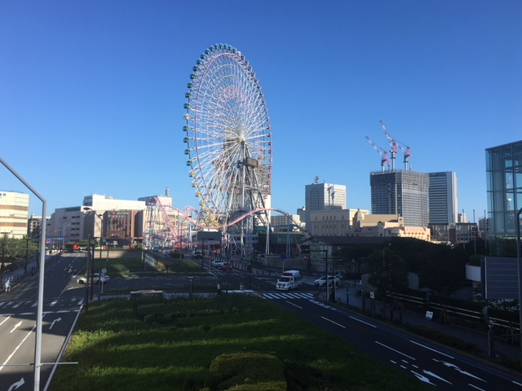
A Few Yokohama Highlights
100 yen store
Cup of Noodles Museum Store
Ramen Noodle Museum - Who knew?
Giant Ferris Wheel

Slide 11
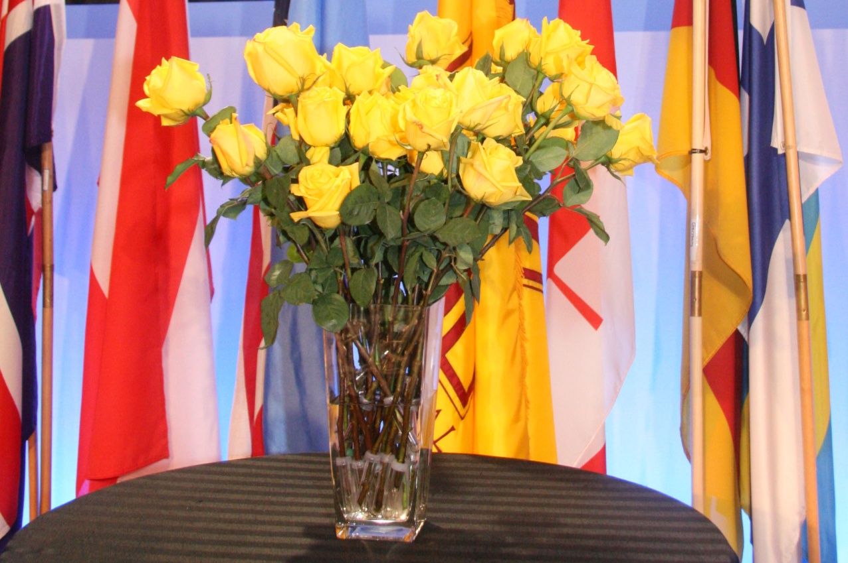

Slide 12
Extra Slides

Slide 13
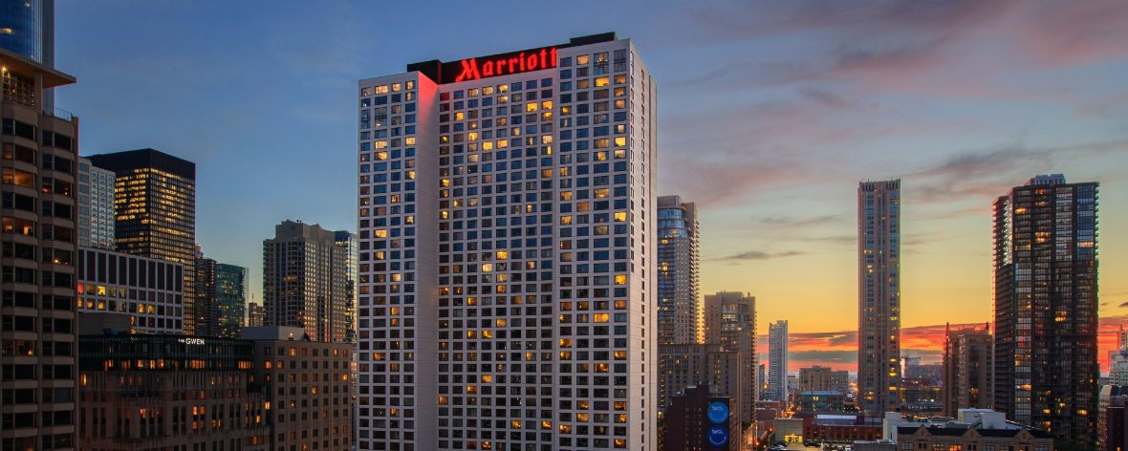
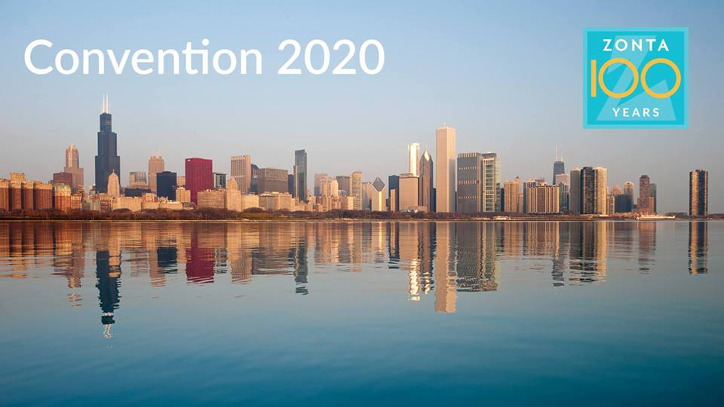
ZI Convention 2020 Chicago Marriott Downtown Magnificent Mile July, 4 – July 8, 2020

Slide 14
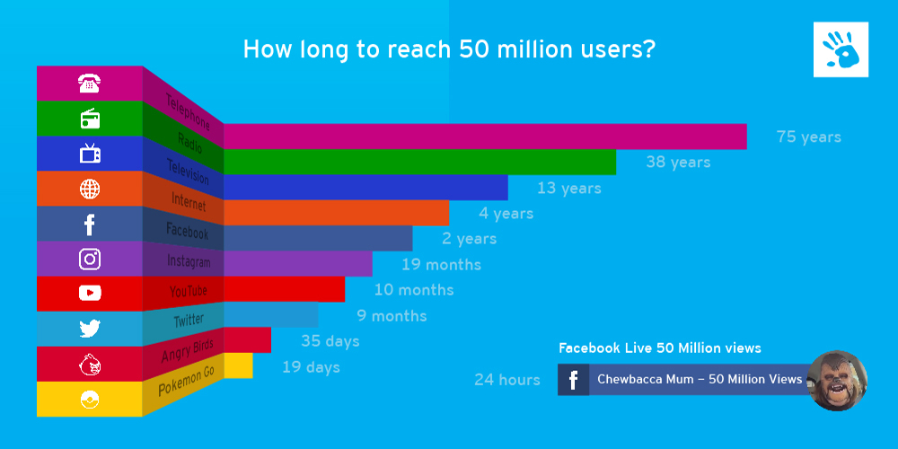
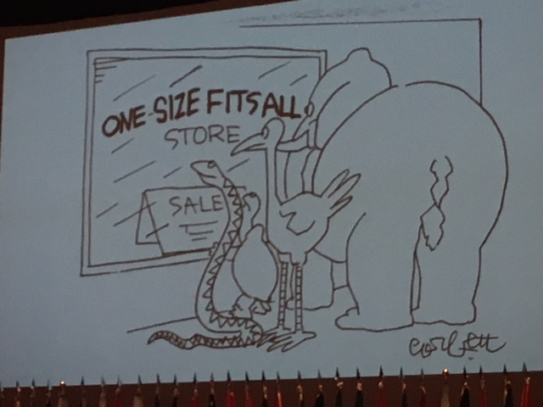
Holly Ransom, 2010 Jane M. Klausman
Women In Business Scholar

